Slide 1
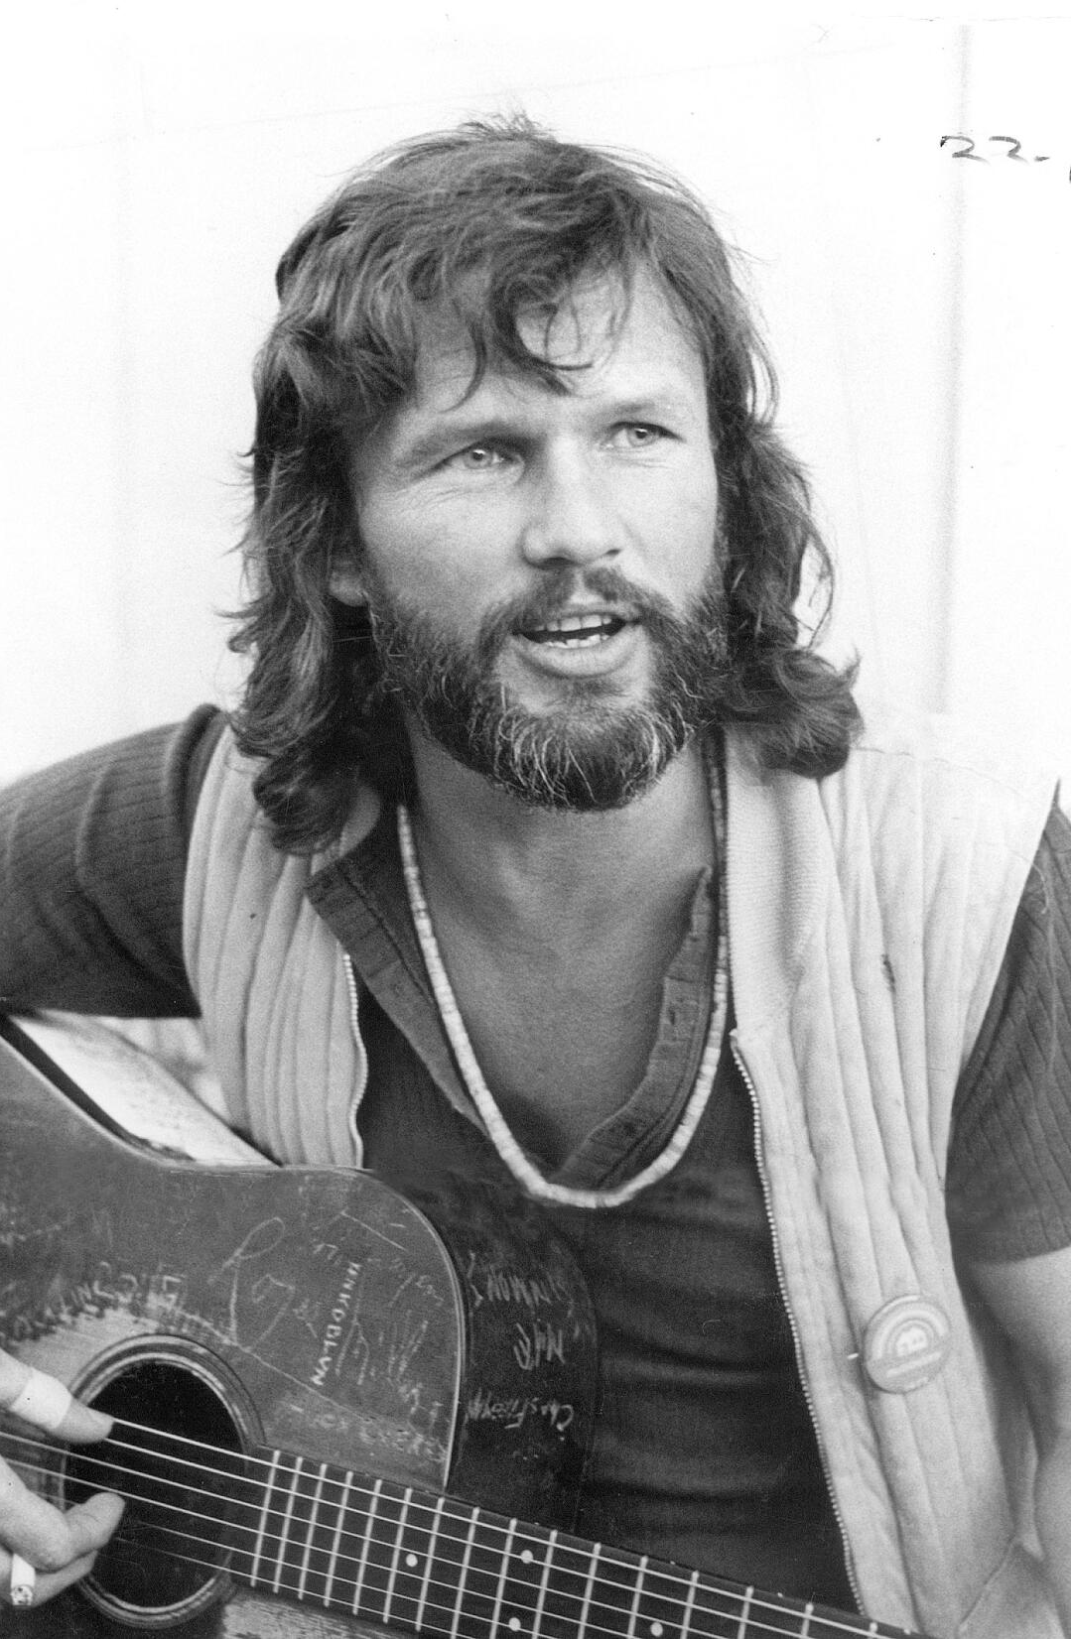
Don’t Let the Bastards Get You Down: Observations on Creating Space and Building Resilience

Slide 2

Notes:
I didn’t come down here to change your mind about anything, but to ease my own mind about everything.

Slide 3
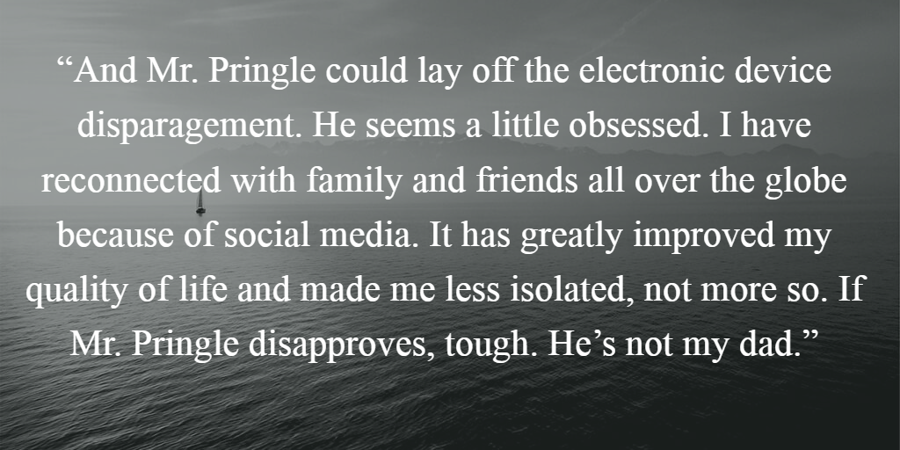
I Am Not Your Dad

Slide 4
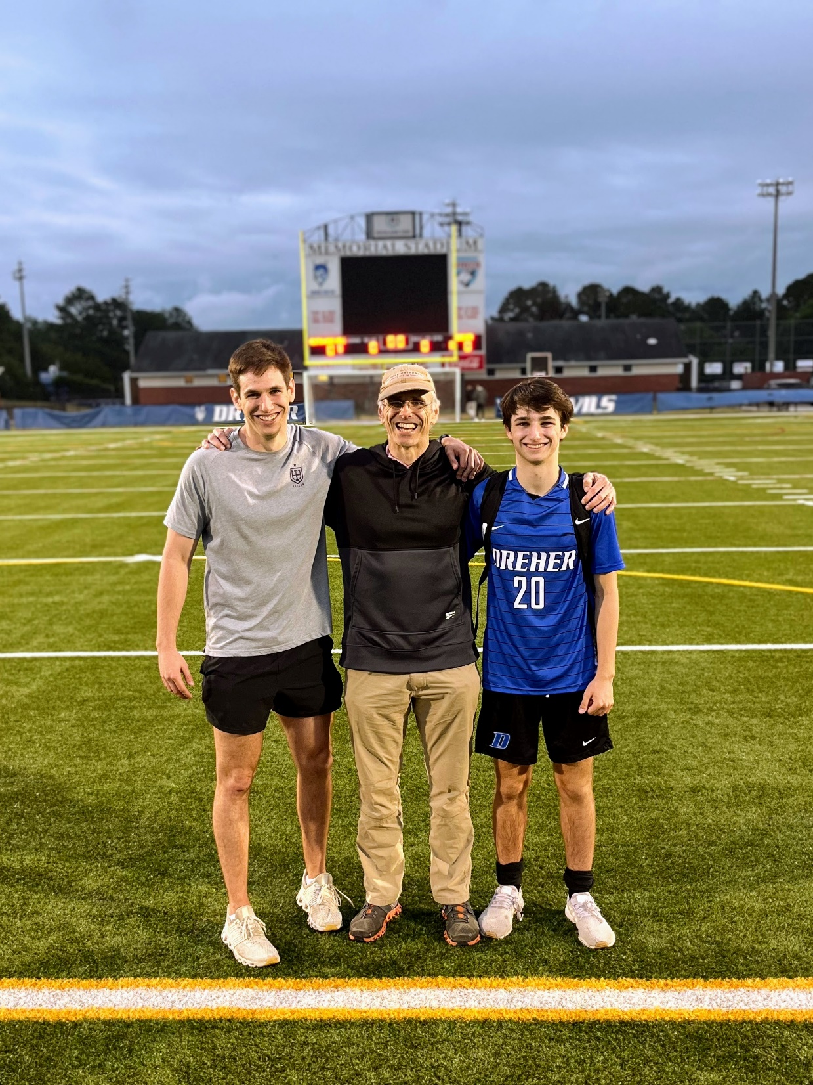

I Am, However, Their Dad

Slide 5
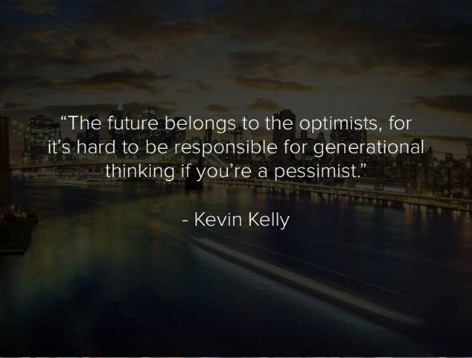
The Why

Slide 6
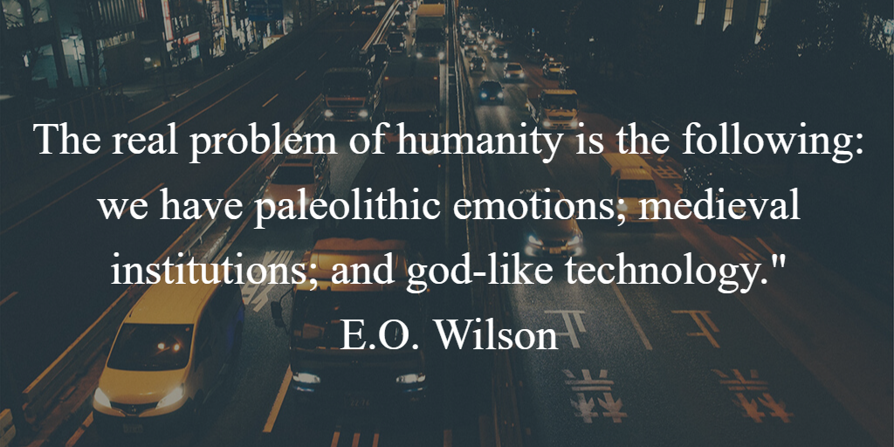

Slide 7

Lens/Frame/Filter for When Thinking’s What You Do
Notes:
Law School is Different. "What do you call everyone in your office who is not you? A Non-lawyer.
The Law is a Jealous Mistress.
What does the law say. Bound by Precedent. BlueBook and Manual on Style

Slide 8
Overview
The Prediction Machine and How it Works
Ways Our Expectations and Perceptions Lead Us Astray
Some Tools to Creating Space for Change

Slide 9
Two Equations from Brad Stulberg
Happiness= Reality – Expectations.
Suffering= Pain x Resistance

Slide 10
Lawyer Tools to Filter and Frame Reality
Your Uniqueness
Work on Your Own/Compete
Avoid Risk and Find Certainty
Think Criticially (With Skepticism, Pessimism)
Follow the Rules/Conform
Play it Safe

Slide 11
Use of the Tools
Seek Compensation, Clients, Advancement
Get Access, Status, Information, Affirmation (from Clients, Decision-makers, Higher-Ups)
Avoid Blame in a Zero-Sum Game
Extrinsic and Linear

Slide 12
The Tools Narrow the Lens
“Please remove the ‘e’ in ‘judgement’ in one of your slides (towards the end).”

Slide 13
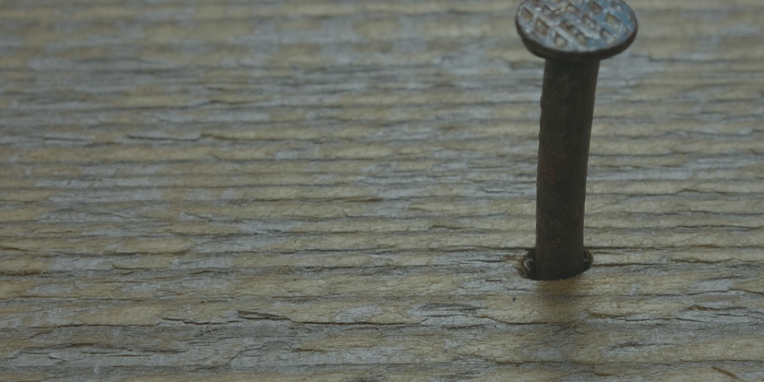
Lawyers Tools and Defaults
Notes:
Your Uniqueness
Seek and Present Information
Work on Your Own/Compete
Avoid Risk and Find Certainty
Think Criticially (With Skepticism, Pessimism)
Follow the Rules/Conform
Play it Safe

Slide 14
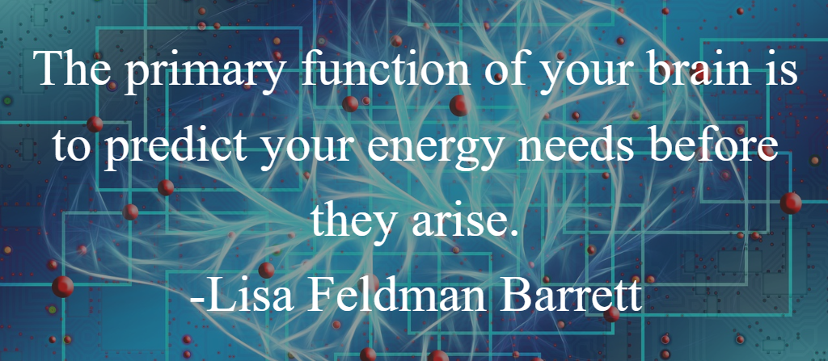
Your Brain is Not For Thinking: It’s a Prediction Machine (So You Don’t Waste Time Thinking)

Slide 15
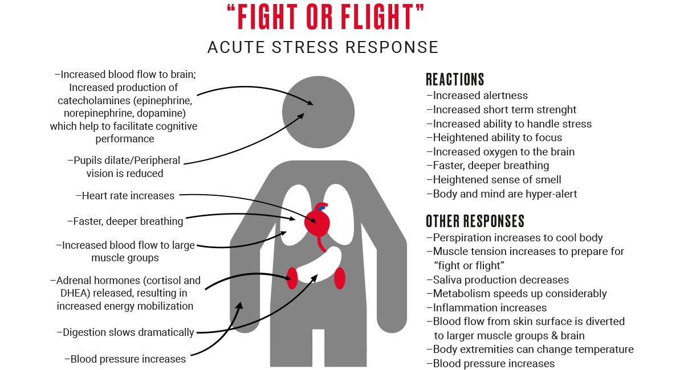
What Does Your Brain Expect to Happen? https://www.polar.com/blog/recovery-from-exercise/

Slide 16
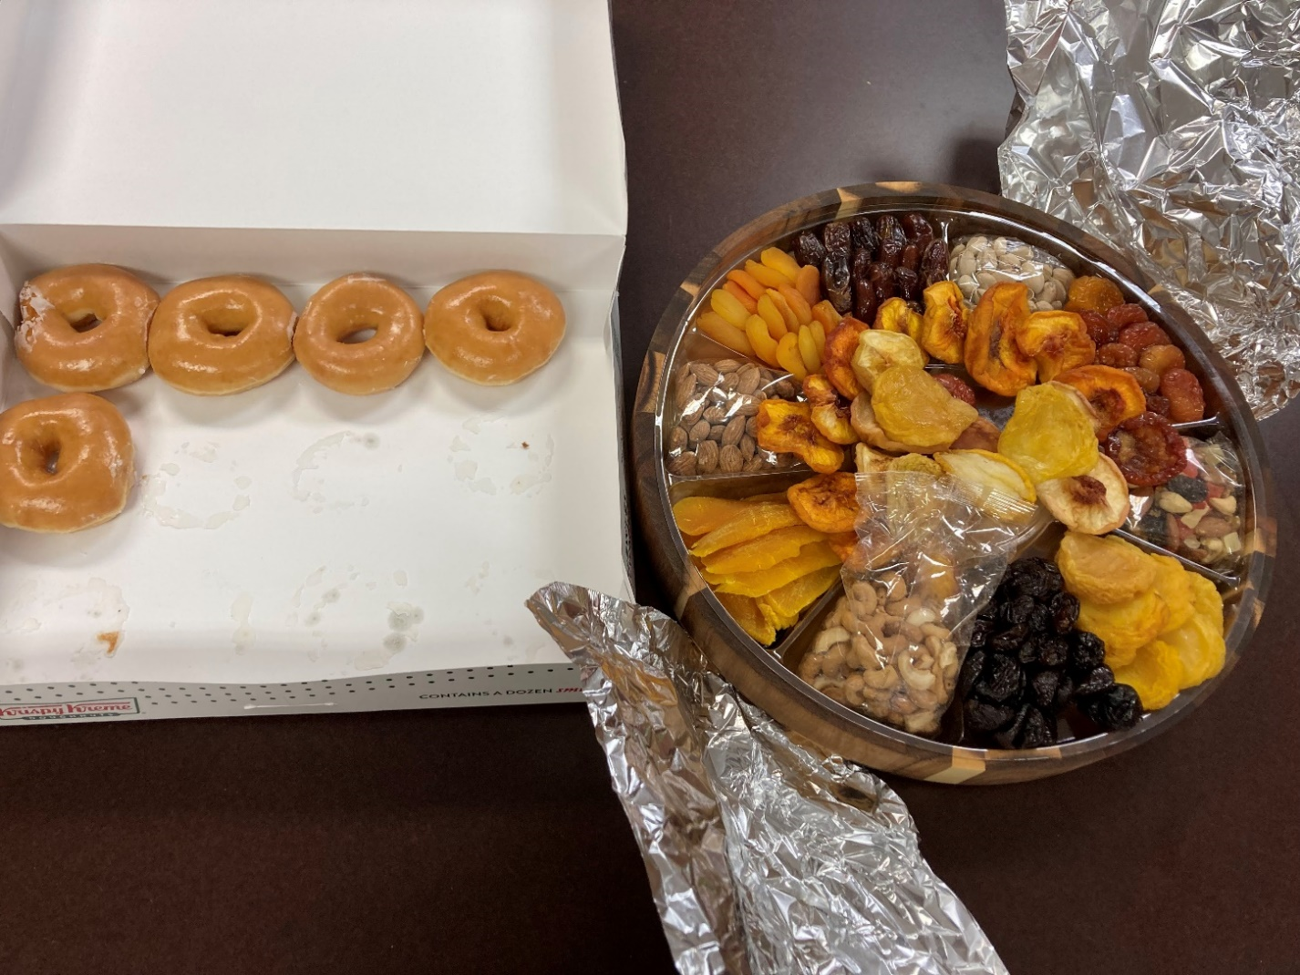
Your Brain Expects You Won’t Eat Again (Scarcity)
Notes:
Variable rewards
Hedonic treadmill
Sugar, salt, fat

Slide 17
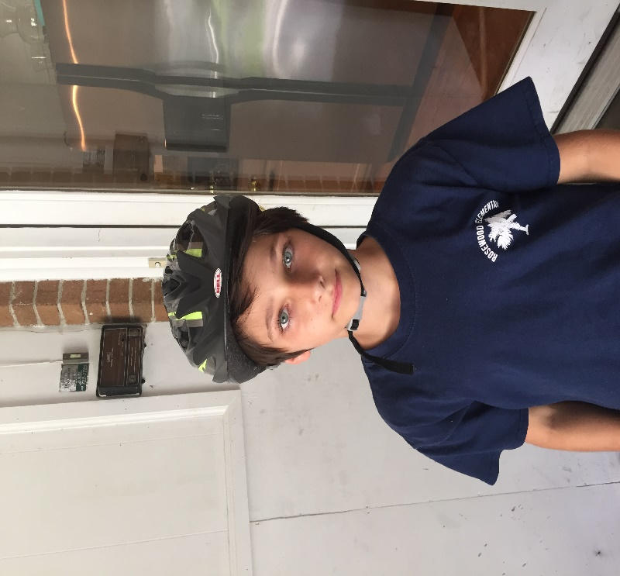
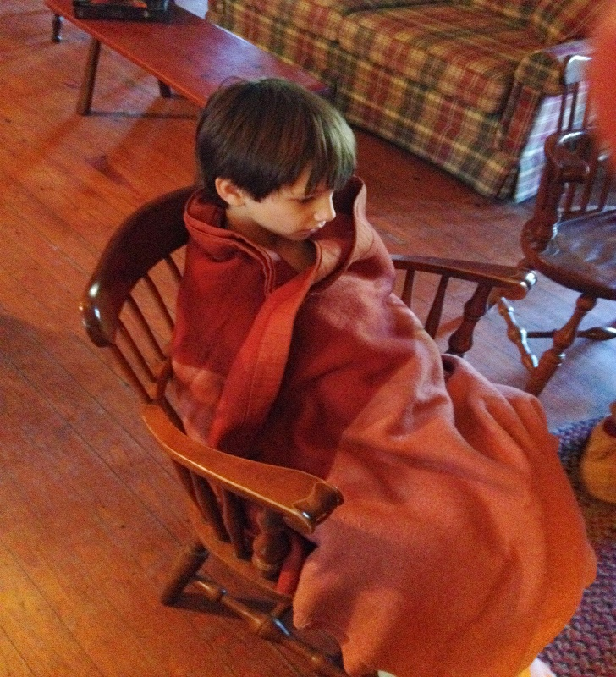
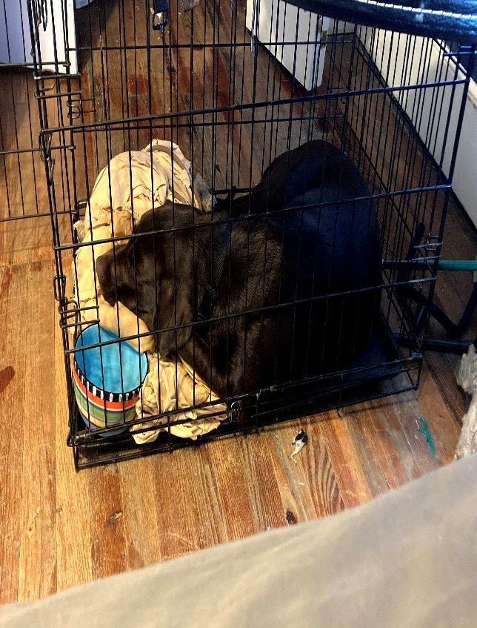
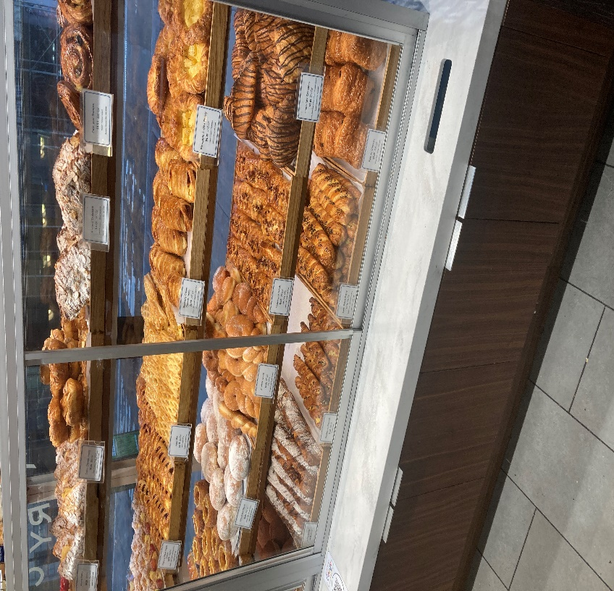
The Prediction Machine Works Well When Scarcity Exists

Slide 18





Perhaps Less So When The Target Just Moves
Notes:
Money, power, pleasure, status/belonging

Slide 19
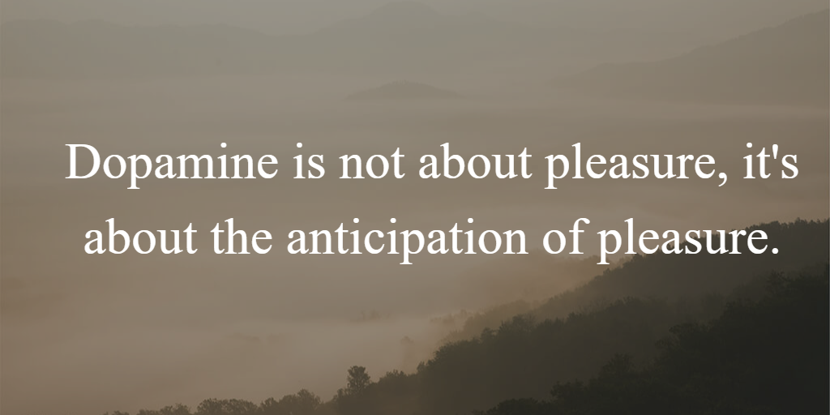
We Can’t Get Enough of Those Expectations . . .
Notes:
Pleasurable, threatening, novel

Slide 20
Cultural Expectations
Suggest to the person next to you that you are not living your best life now, and in fact things have gotten precipitously worse since last you met. And then notice the kind of responses you get . . .

Slide 21

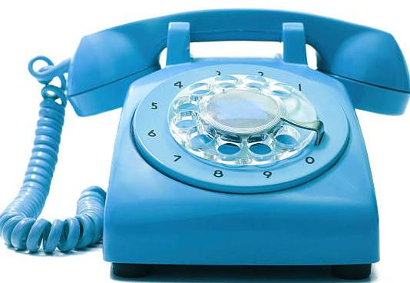
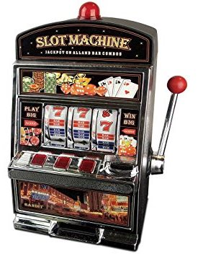


Our Expectations Make Us a Tool

Slide 22
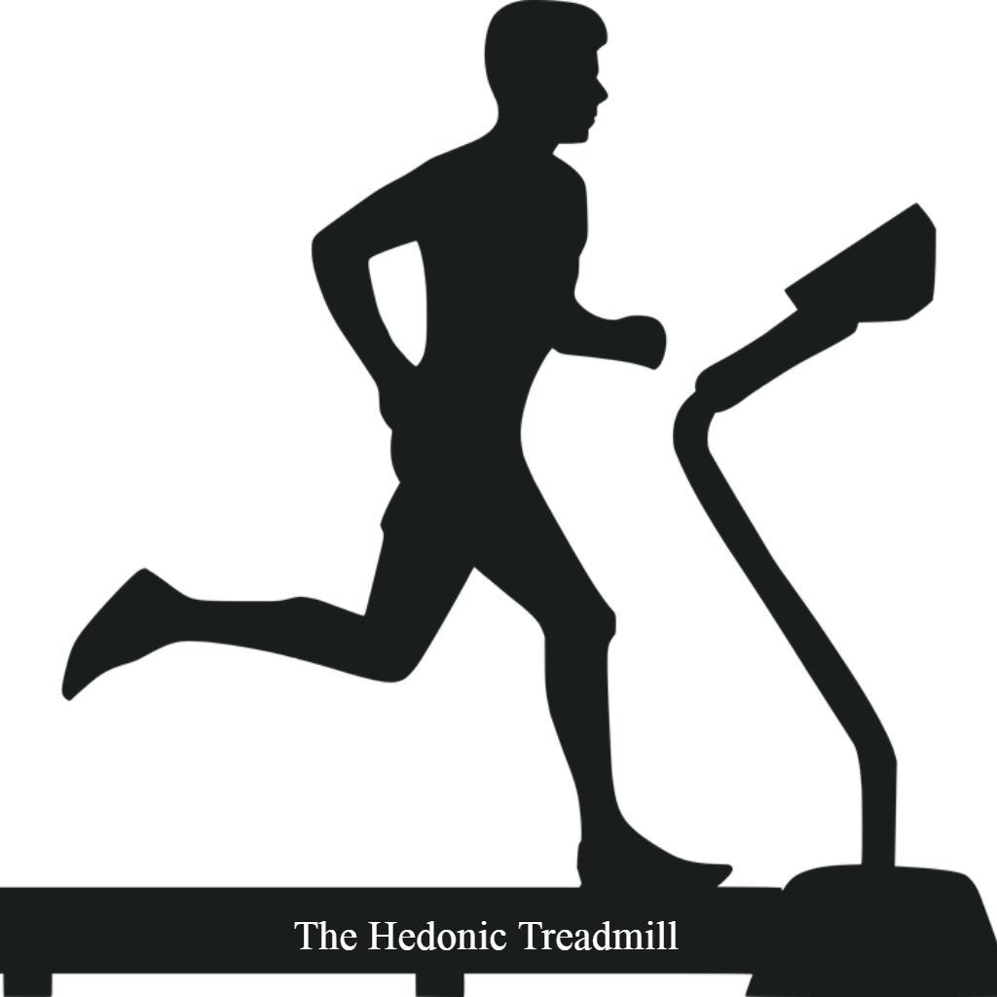
Expectations Ratchet up …

Slide 23
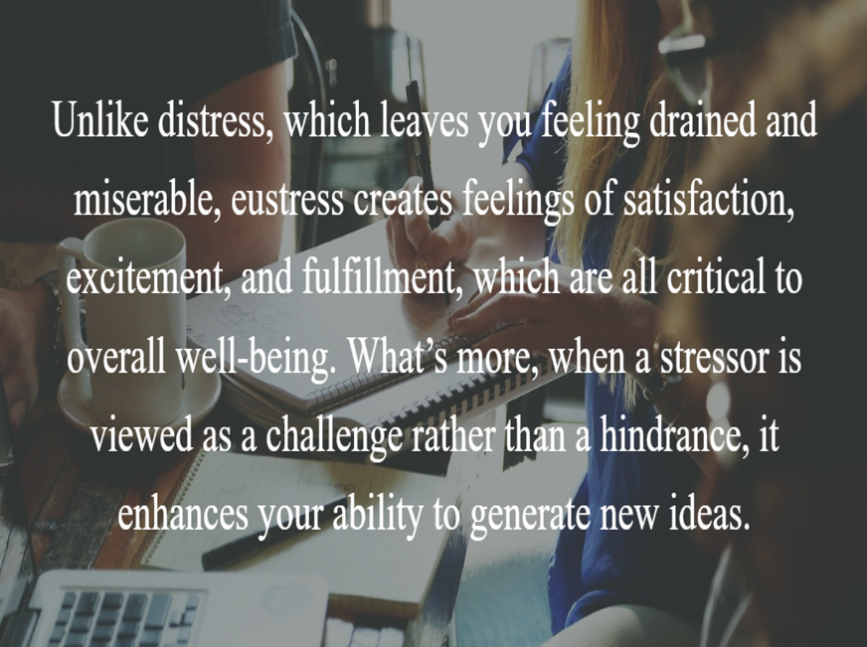
Reframing One Tool: Intentional Stress is Good

Slide 24
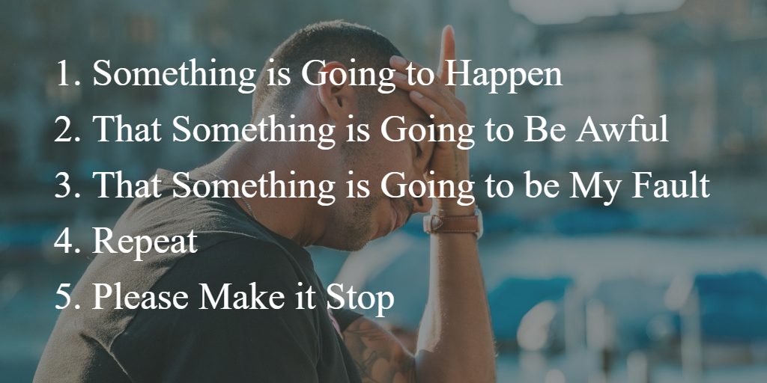
The Distress of Chronic Expectations
Notes:
Might mean that understanding emotions and dealing with them are the keys.

Slide 25

Chronic Stress (No Recovery)
Notes:
Interferes with learning and memory
lower immune function and bone density
increased weight gain, blood pressure, cholesterol, heart disease
increase risk for depression, mental illness, and lower life expectancy.
potential trigger for mental illness and decreased resilience—especially in adolescence.

Slide 26

What Do We Miss When Distress Sticks?
Notes:
What to ThinkCapability to Manage Emotion
Space to Respond (Rather Than React)
Context/Awareness
Cooperation/Collaboration/Communication (Listening)
The Willingness to Change (Curiosity, Creativity)
(We all got holes to fill, and them holes are all that’s real . . .)
(Turn Off The Brain)
A Reminder from Time to Time that Things Are Relatively Easy
(Why Do You Need Space?- Creativity-Risk-Vulnerability)

Slide 27
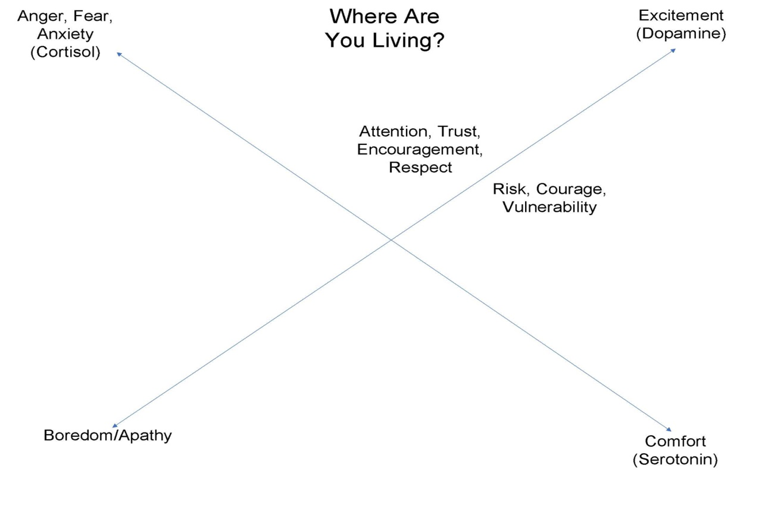
Notes:
We are “problem solvers”, but often
unaware of the problem (especially when the problem is us)
Unaware of any clue how to solve it;
But absolutely certain that we do know or unwilling to admit otherwise.
Most of us live mindlessly all of the time-
Using the Tools We Have means we don't see the whole picture and miss what is right in front of us
Not there and not there to know we are not there
You are Not So Smart (False Consensus) – Lee Ross- believing that from situation to the next, people are more likely to do things or see the world the way we do. Ambiguity, doubt.
we don't perceive everything that is important.
Our brains and emotions don’t always make sense of the world
Naïve realism

Slide 28
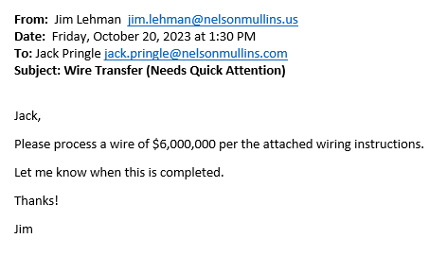
Urgent Expectations
Notes:
Trust, belief, impatience, urgency, greed, lust

Slide 29
Shortcuts and Perception of Reality
Natural Selection and Survival
The Tribe
The Fundamental Attribution Error

Slide 30
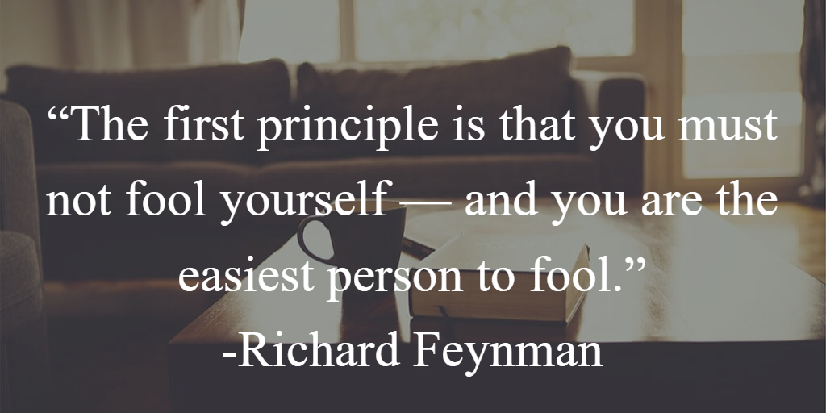

Slide 31
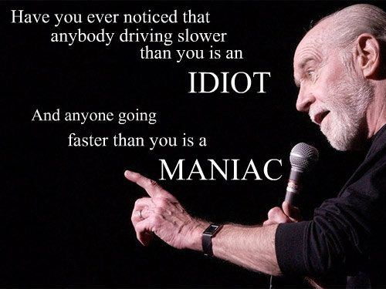
My Perception, My Reality
Notes:
The blind spots the prediction machine creates

Slide 32
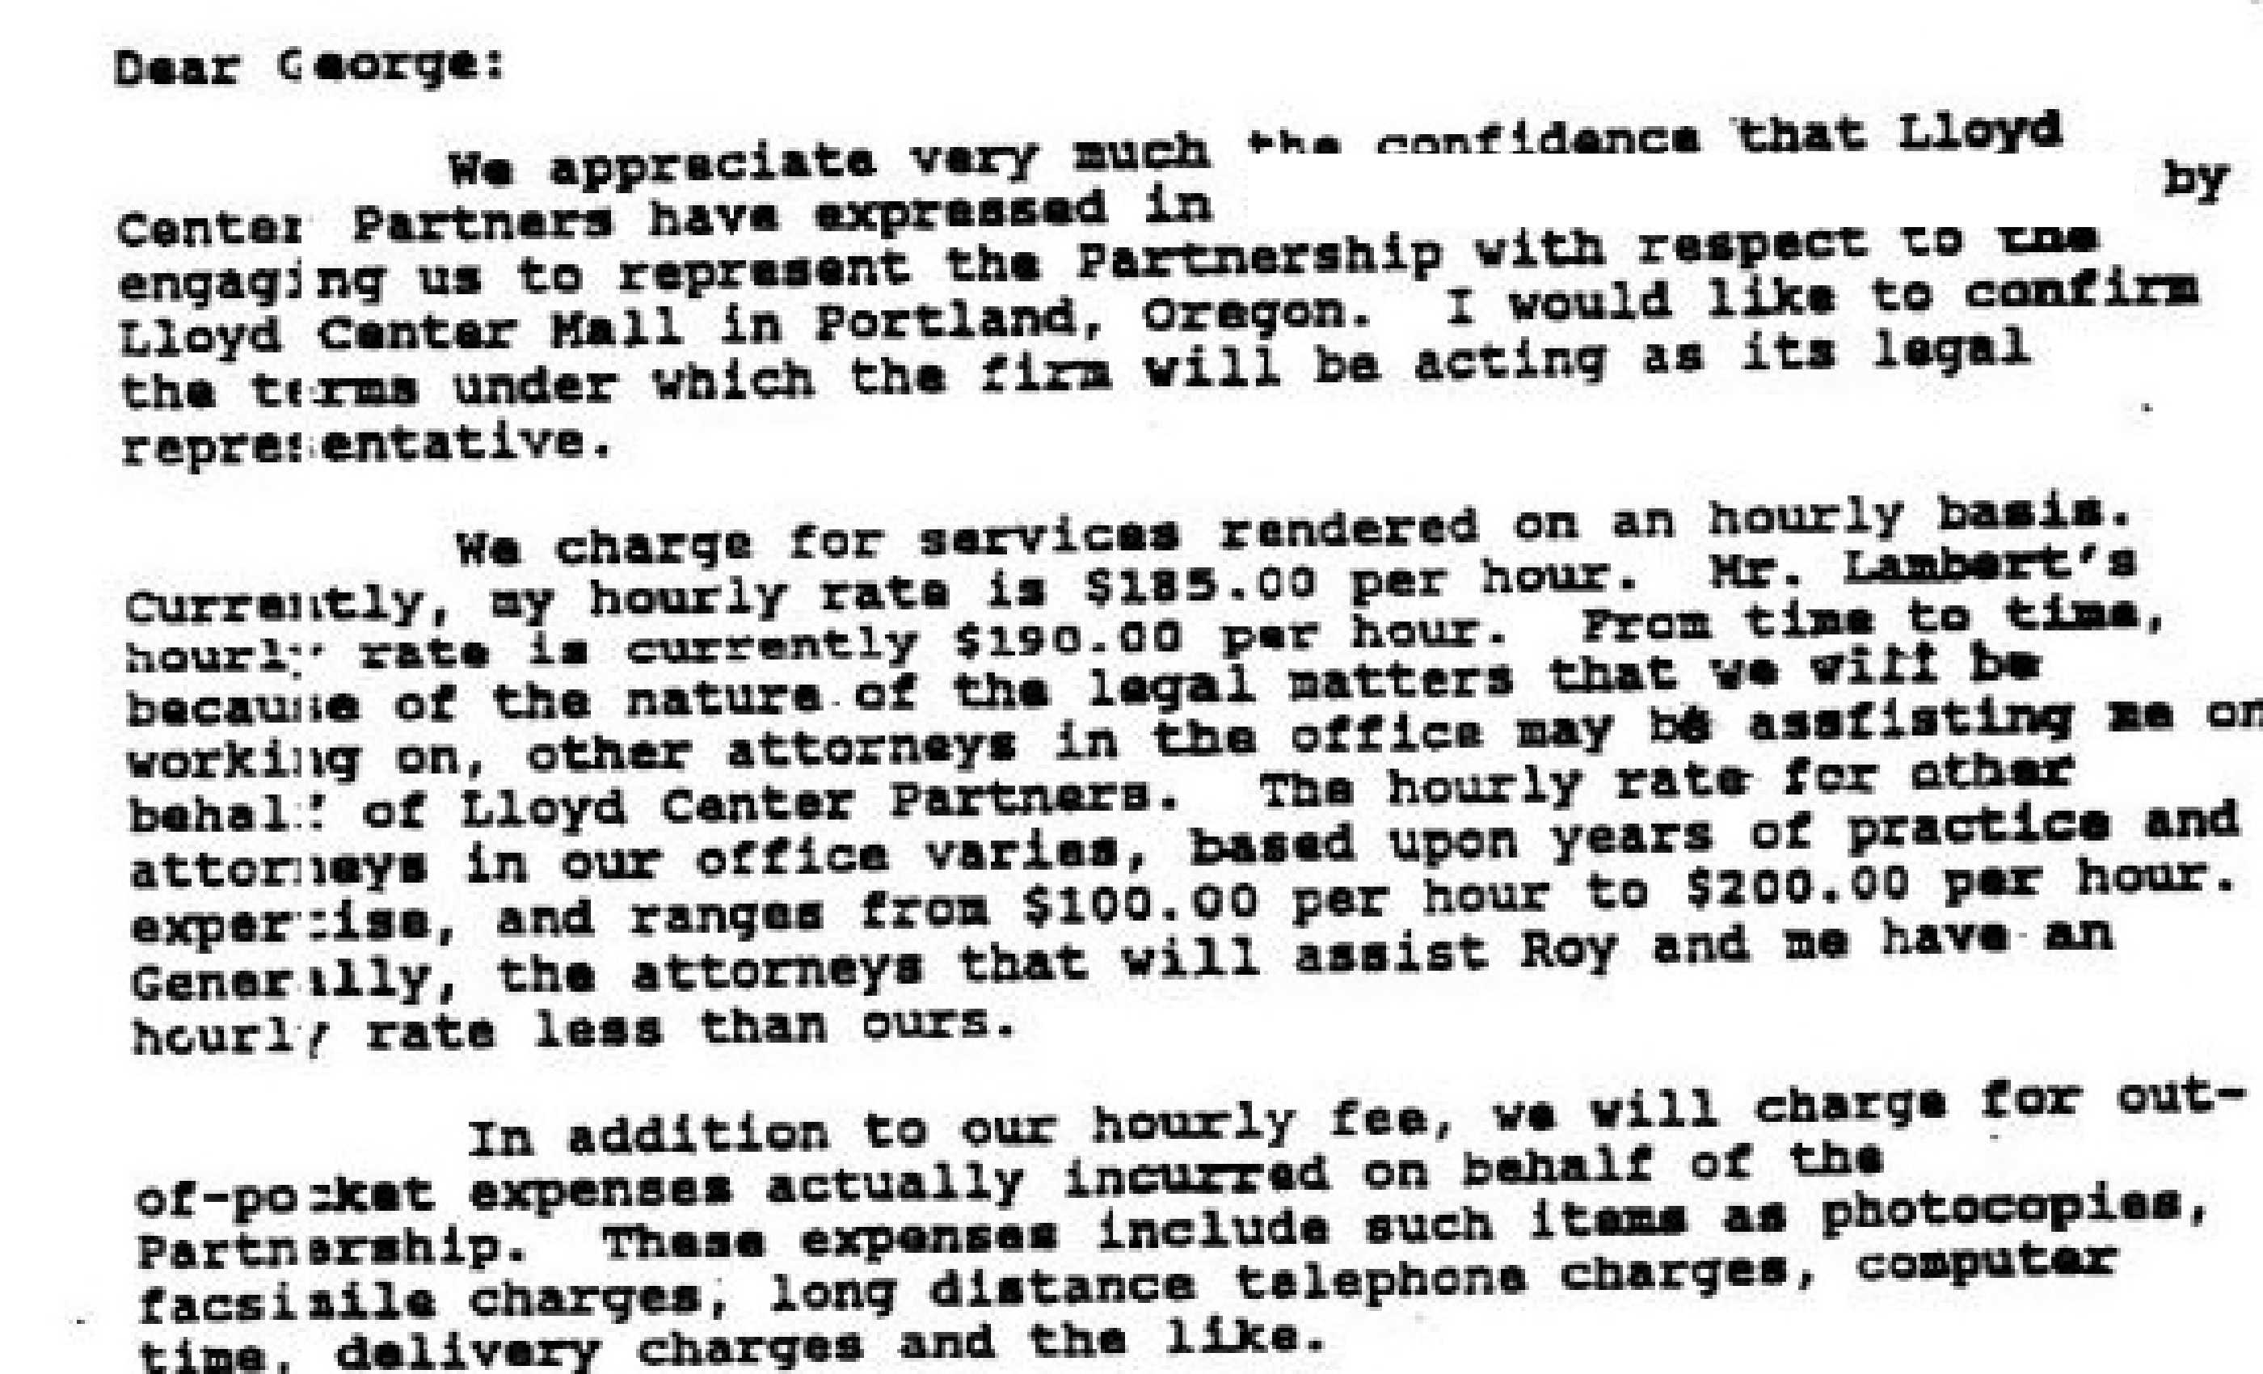

Slide 33
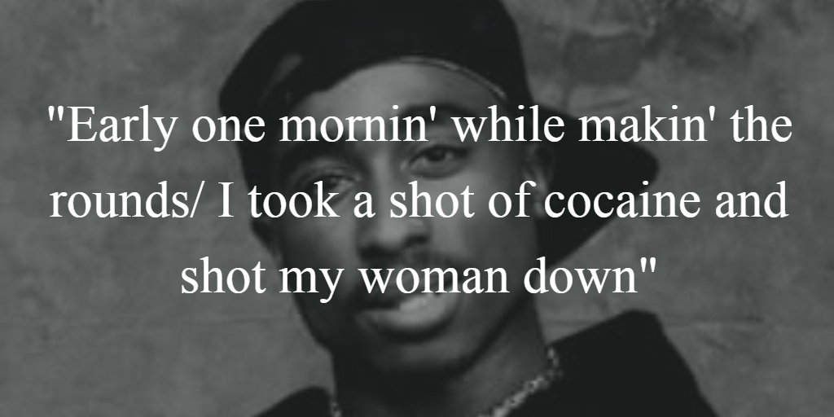

Slide 34
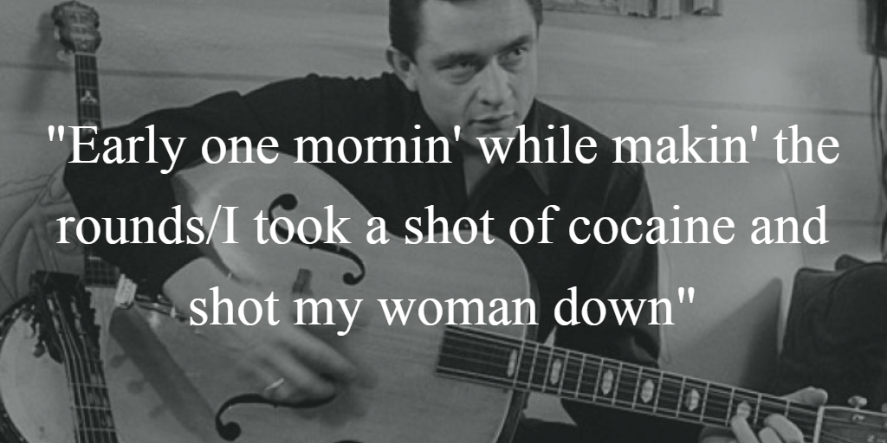

Slide 35
Notice The Stories You Tell (Where Reality and Expectations May Diverge)
Livin’ the Dream
Another Day in Paradise
My Dad didn’t do any housework
These Goldern Millennials and Everybody Gets a Trophy
These Goldern Baby Boomers Just Trying to Retire
I Don’t Think ______ Woulda’ Done it This Way
I Don’t Do Technology
What happened to all the associates?
I Just Want to Retire Before Things Get Any Crazier.

Slide 36
Hanlon’s Razor
“Don’t attribute to malice something that can be simply explained by incompetence.”
Notes:
Less evaluative of other people; feel unique but recognize that everyone is also unique; ability to take risks.
Situational rather than personality-based.
(When You notice Things about yourself, you notice things about others) (opposite of projection).
Gets you off your back foot and in a posture of being ready to actively solve problems and create possibilities
David Allen and the open loop.
Hard not to be humble when you see the way your brain works.

Slide 37


Slide 38
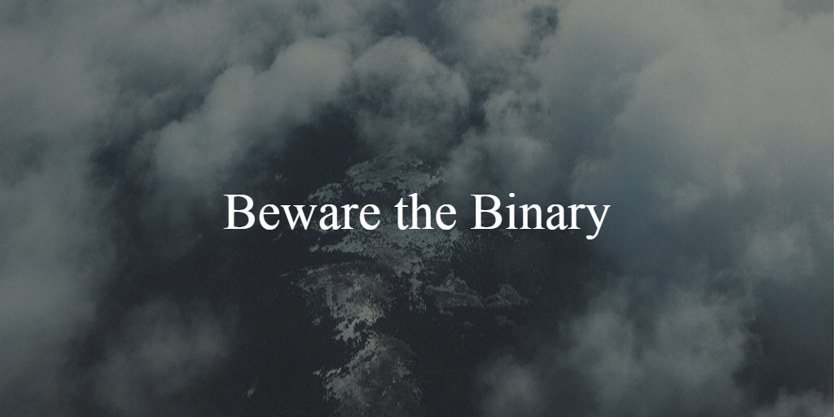
Widen the Lens to Allow Yes, AND

Slide 39

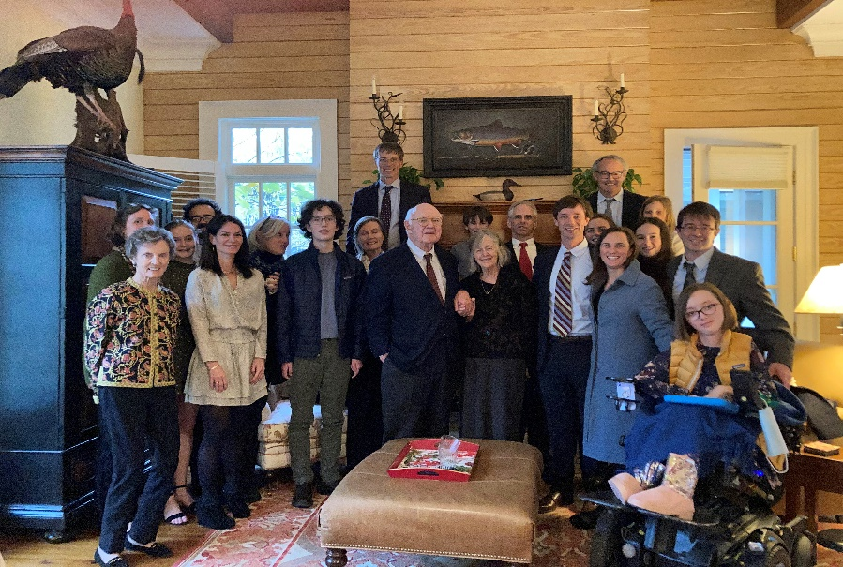
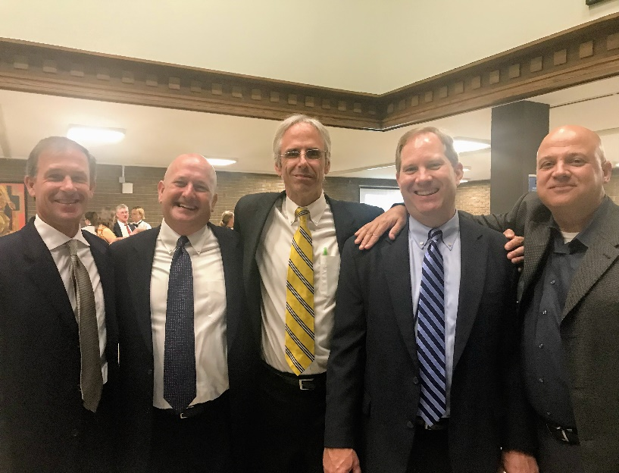
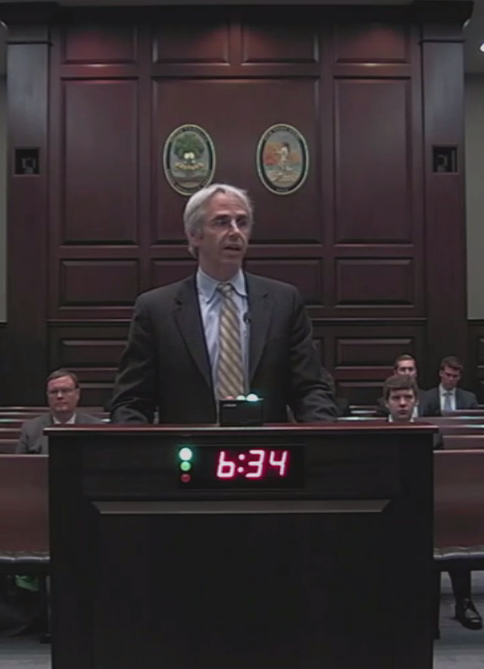
Widening the Lens is Relatively Easy
Notes:
Faith, Family, Friendship, Work That Serves

Slide 40
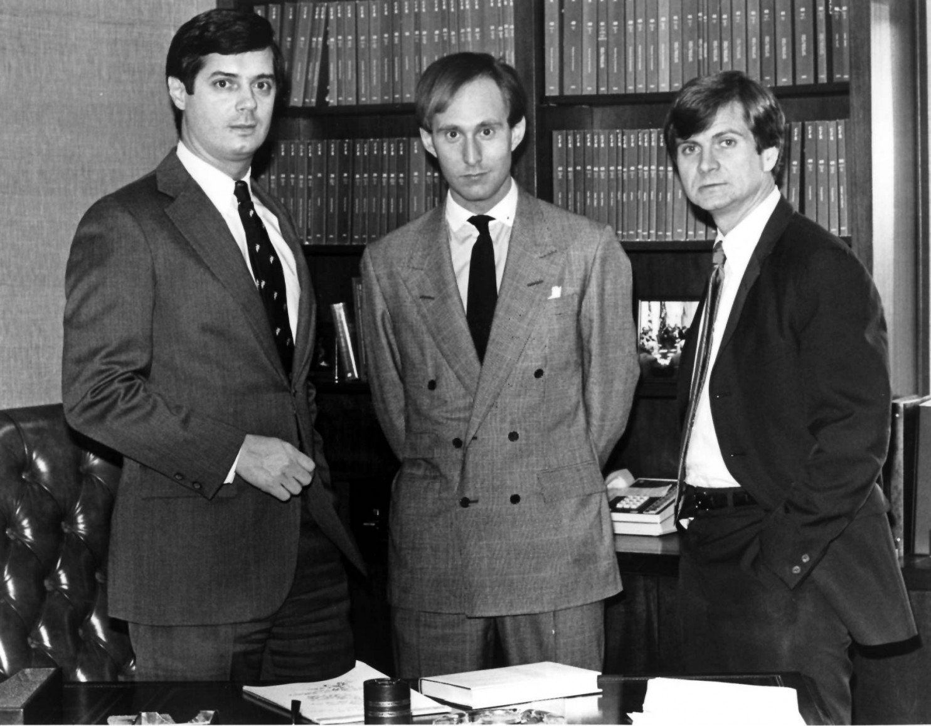
Humanity, Love, Brotherhood, Relationships
Notes:
My illness has taught me something about the nature of humanity, love, brotherhood, and relationships that I never understood, and probably never would have. So, from that standpoint, there is some truth and good in everything."^{[11]} Turnipseed accepted Atwater's apology and later attended his funeral.
In a February 1991 article for Life, Atwater wrote:
My illness helped me to see that what was missing in society is what was missing in me: a little heart, a lot of brotherhood. The 1980s were about acquiring – acquiring wealth, power, prestige. I know. I acquired more wealth, power, and prestige than most. But you can acquire all you want and still feel empty. What power wouldn't I trade for a little more time with my family? What price wouldn't I pay for an evening with friends? It took a deadly illness to put me eye to eye with that truth, but it is a truth that the country, caught up in its ruthless ambitions and moral decay, can learn on my dime. I don't know who will lead us through the '90s, but they must be made to speak to this spiritual vacuum at the heart of American society, this tumor of the soul.^{[41]}

Slide 41
Ways To Notice Your Short Cuts
Give Your Brain What it Needs
Make Observations Rather than Judgements
Seek Out Counterfactuals
Change Predictions as You Gather Evidence
Develop Empathy
Be Curious

Slide 42

Fear (“Need” for Safety) and Curiosity (Willingness to Learn and Change) Can’t Co-Exist
Notes:
Replace “why is this happening?” with “what is happening?”

Slide 43
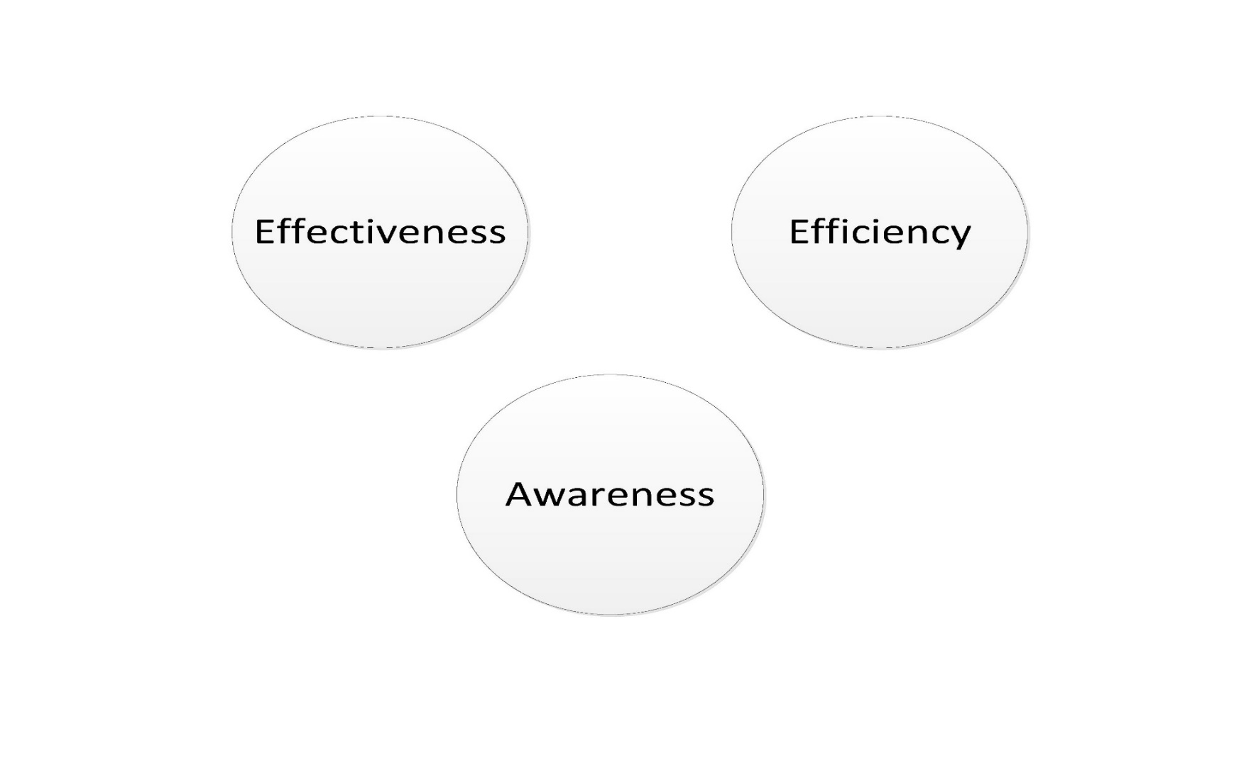
Let Go to Get a Clear(er) View of Reality

Slide 44
Tools to Respond and Recover (Build Space and Energy to Adapt)
Breath
Exercise
Habits and Routines (Process), but not Ruts
Allow for Rest and Recovery
Cultivate Awe
Notes:
Brain-derived neurotropic factor (BDNF). Helps new synapses grow, produce new neuronns

Slide 45
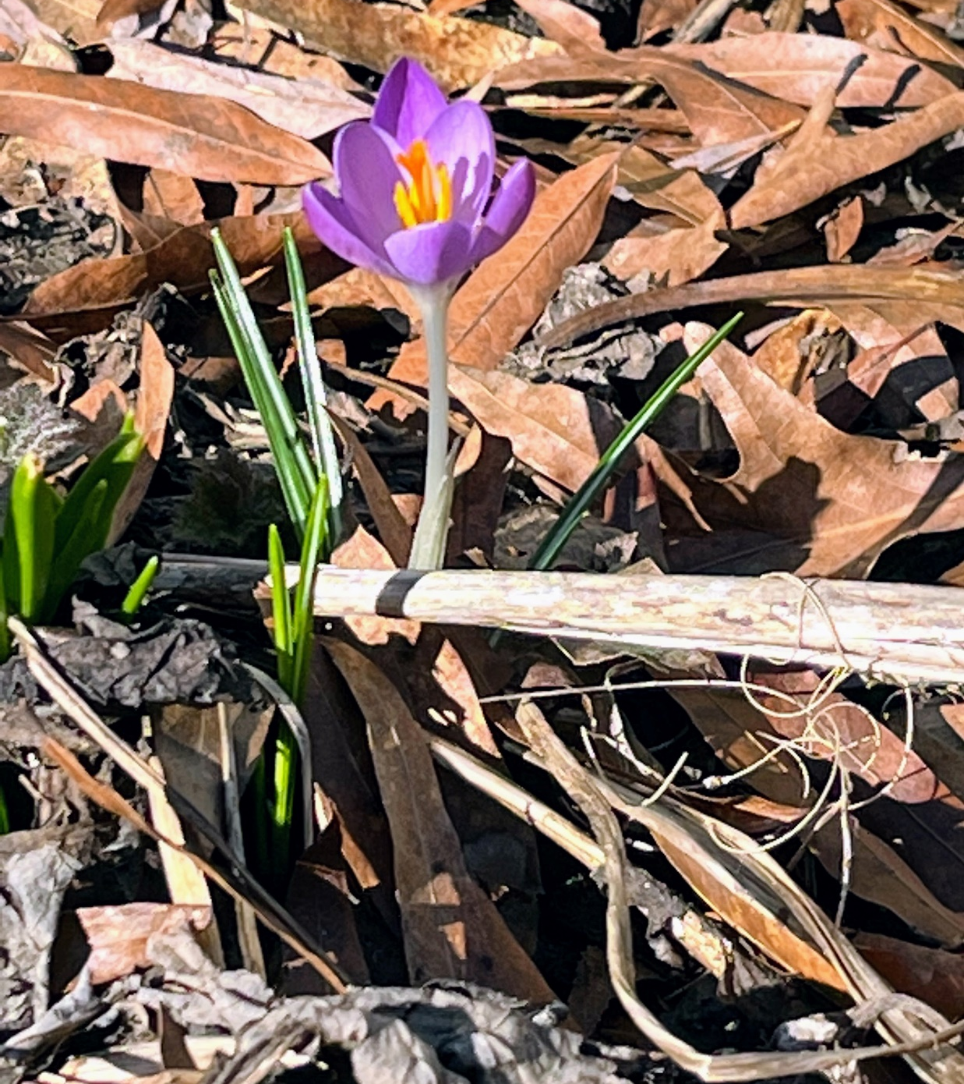
Space for Awe

Slide 46
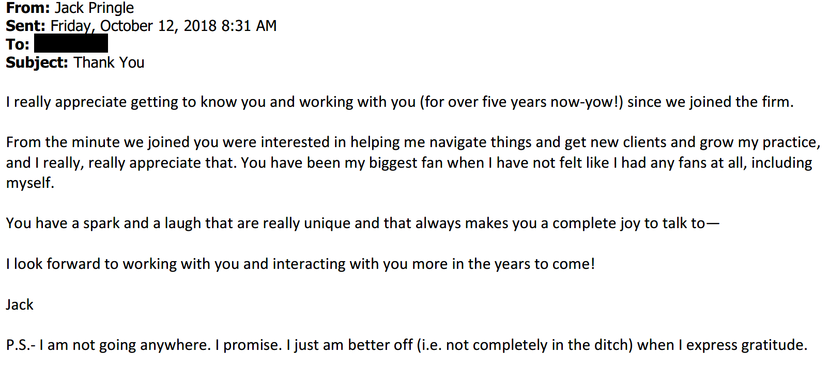
Practice Gratitude -5 Minutes a Day

Slide 47
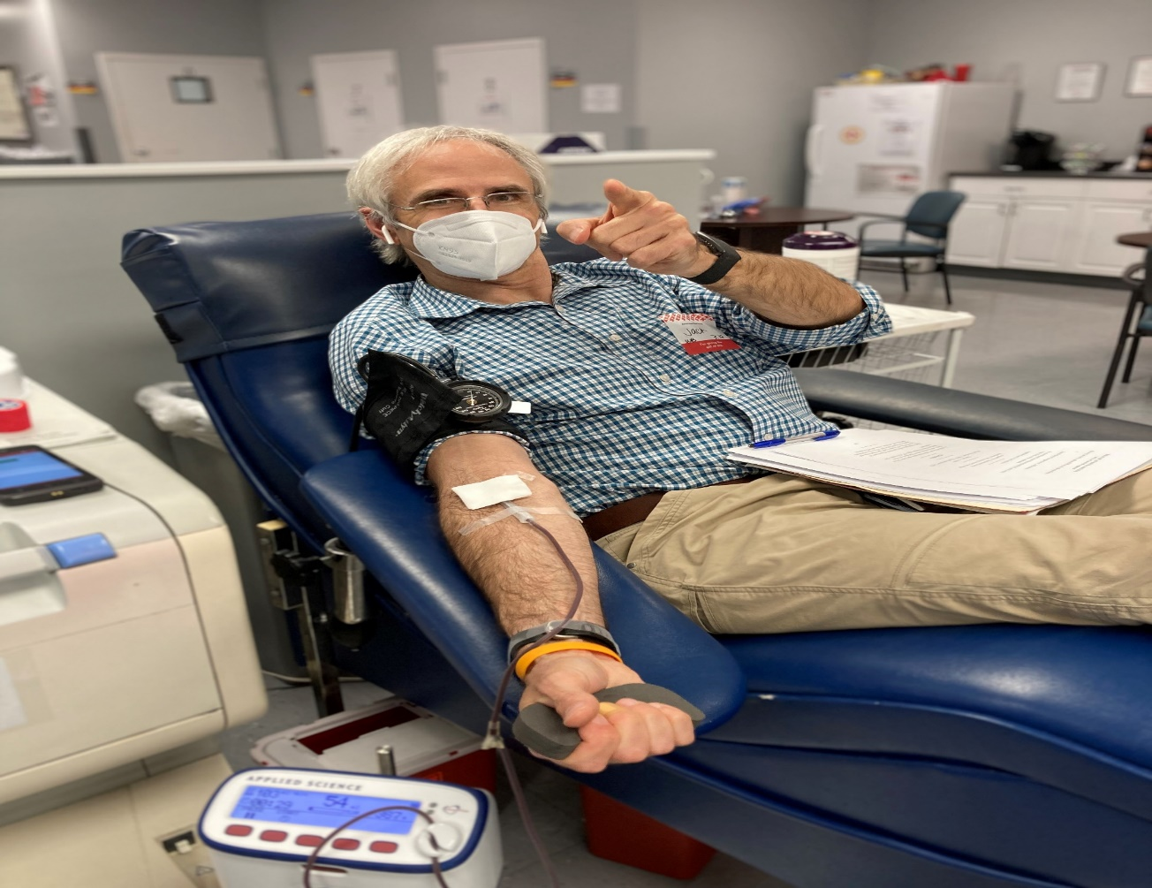
Practice Gratitude By Giving
Notes:
(Put Your Own Mask on) (When You notice Things about yourself, you notice things about others) (opposite of projection).
Shame can’t survive emphathy: (Shame Needs Three Things: secrecy, silence, judgment)
Be seen
If I am going to fall prey to cliches, I will choose these.

Slide 48

Find the Circles

Slide 49
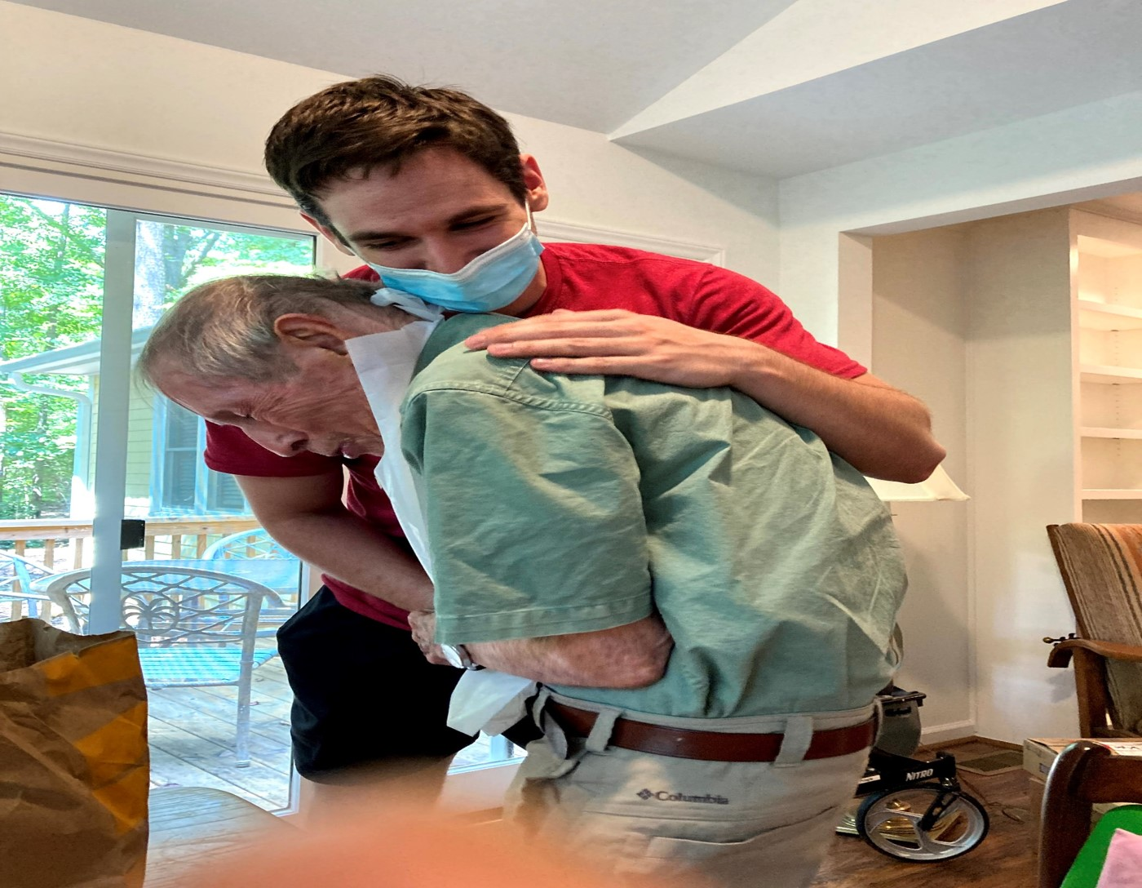
Dance with the Elephant
Notes:
Butthe best examplesI can give of his courage and love is the way he faced his Parkinson’s andhis mortality in asuch aclear-eyed and positive way. It was an extraordinary comfort and gift tome and to all ofus that Daddy could confront and prepare for the inevitable.He planned with allof us in mind.In the midst of all that uncertainty he put us all at ease.So, paradoxically enough, (and the paradoxes are really where we live this life), Daddy-the manofreason-taught mewhatfaithis.Faith for me is not some sense ofabsolutecertainty-Instead, faith meanshaving the courage tomove through doubt and risk with grace and intention. And to be brave and helpful for otherseven when you don’t necessarilyfeel that wayand you don’t know how things might turn out

Slide 50
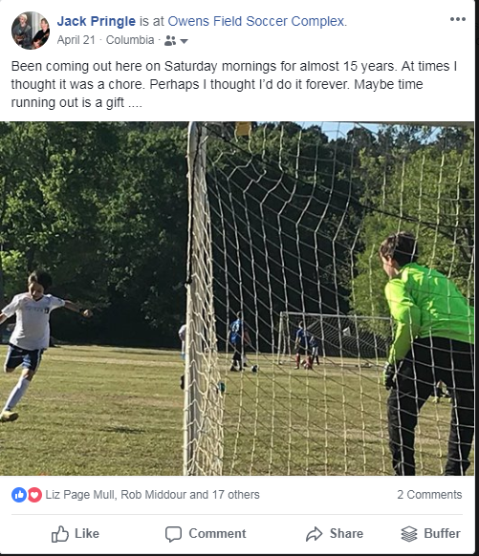
Embrace the Paradoxes . . .

Slide 51
Resources
Brad Stulberg, Master of Change: How to Change When Everything is Changing – Including You,
https://www.amazon.com/Master-Change-Everything-Changing-Including/dp/006325316X
Jeena Cho, The Anxious Lawyer, https://www.amazon.com/Anxious-Lawyer-Satisfying-Mindfulness-Meditation/dp/1627226249
Baba Shiv, How Do You Find Breakthrough Ideas?, Stanford Graduate School of Business, http://www.gsb.stanford.edu/insights/baba-shiv-how-do-you-find-breakthrough-ideas
The Resilient Lawyer http://theanxiouslawyer.com/rl-23-jack-pringle/
Farnham Street https://www.farnamstreetblog.com/
One You Feed With Michael Taft http://www.oneyoufeed.net/michael-taft/
Tim Ferris with Brene Brown http://fourhourworkweek.com/2015/08/28/brene-brown-on-vulnerability-and-home-run-ted-talks/
On Being With Ellen Langer http://www.onbeing.org/program/ellen-langer-science-of-mindlessness-and-mindfulness/6332
You Are Not So Smart http://youarenotsosmart.libsyn.com/062-naive-realism-lee-ross-0
“Living (Happily) Surrounded by Conflict: Surprise! How Lawyers are Leading the Mindfulness Revolution,” Judi Cohen, http://warriorone.com/wp-content/uploads/2015/03/Living-Happily-Surrounded-by-Conflict.pdf
“What Resilient Lawyers Do Differently,” Paula Davis-Laack, https://www.forbes.com/sites/pauladavislaack/2017/09/26/what-resilient-lawyers-do-differently/#67617c313495

Slide 52
More Resources
The Checklist Manifesto: How to Get Things Right, by Atul Gawande http://www.amazon.com/Checklist-Manifesto-How-Things-Right/dp/0312430000
Where Ancient Faiths Meet Modern Lives, Aspen Ideas to Go, https://www.aspenideas.org/podcasts/where-ancient-faiths-meet-modern-lives
Mindset: The New Psychology of Success, by Carol S. Dweck, Ph.D http://www.amazon.com/Mindset-Psychology-Success-Carol-Dweck/dp/0345472322
Give and Take: Why Helping Others Drives Our Success, by Adam Grant http://www.amazon.com/Give-Take-Helping-Others-Success/dp/0143124986
The Algebra of Happiness: Notes on the Pursuit of Success, Love, and Meaning, Scott Galloway, https://www.amazon.com/Algebra-Happiness-Pursuit-Success-Meaning/dp/0593084195
“Art of Letting Other People Have Your Way: Negotiating Secrets with Chris Voss,” The Knowledge Project Podcast, https://www.farnamstreetblog.com/2018/01/chris-voss/
“How Jon Hamm and Rob Dyrdek Stay Reslient”, https://www.wsj.com/articles/jon-hamm-rob-dyrdek-resilient-11632486870?fbclid=IwAR39zUpFinudaNvQh1pHo1lbLDK0FzoiQ8jOnzK9K10zY0GxoNya6Uxo7f0
“Here’s why a dose of intentional stress can supercharge your team,” Britt Booth, Fast Company https://www.fastcompany.com/90600010/heres-why-a-dose-of-intentional-stress-can-supercharge-your-team

