Slide 1
2024 REESE JOYE
A DUI HISTORY
November 8, 2024
Columbia, SC
JIM HUFF, ESQUIRE
HUFF LAW FIRM, PC
1417 Georgia Ave.
North Augusta, SC 29841
jhuff@hufflaw.org
www.scdui.com
803-278-2889 office

Slide 2
CHALLENGES ENCOUNTERED

Slide 3
  ALCOHOL MAKES YOU DRUNK!

Slide 4
The first major English statute on intoxication was an acted in 1606 (4 Jac. I, c. 5). The preamble provided “whereas the loathsome and odious sin of drunkenness is of late grown into common use within this realm, being the root and foundation of many other enormous sins, as bloodshed, stabbing, murder, swearing, fornication, adultery, and such like, to the great dishonor of God,

Slide 5
and of our nation, the overthrow of many good arts in manual trades, the disabling divers workmen, and the general impoverishing of many good subjects, abusively wasting the good creatures of God…”

Slide 6
The penalty for each conviction was five shillings. Per Blackstone, if the offender was unable to pay the fine, he was to be "committed to the stocks for every offense, they are to remain by the space of six hours,” "by which time the statute presumes the offender will have regained his senses, and not liable to do mischief to his neighbors.”

Slide 7
DUI LAWS

Slide 8
In 1910, New York adopted the first law against drinking and driving.

Slide 9
Laws of N.Y
Ch. 374, § 290(3), [1910]

Slide 10
PUNISHMENT
Punishment for operating motor vehicle while in an intoxicated condition ... Whoever operates a motor vehicle while in an intoxicated condition shall be guilty of a misdemeanor. . . . [If any person be convicted a second time.. . he shall be guilty of a felony punishable by imprisonment for a term of not less than one year and not more than five years

Slide 11
SUSPENSION
A conviction of a violation of this subdivision shall be reported forthwith by the trial court or the clerk thereof to the secretary of state, who shall upon recommendation of the trial court suspend the license of the person so convicted.

Slide 12
“INTOXICATED” DEFINED
"that one shall not be affected by alcoholic beverage to such an extent as to impair his judgment or his ability to operate an automobile."
People v. Weaver, 188 App. Div. 395, 400, 177 N.Y.S. 71, 74 (3d Dep't 1919)

Slide 13
One "is intoxicated when he has imbibed enough liquor to render him incapable of giving that attention and care to the operation of his automobile that a man of prudence and reasonable intelligence would give."
People v. Weaver, 188 App. Div. 395, 400, 177 N.Y.S. 71, 74 (3d Dep't 1919)

Slide 14
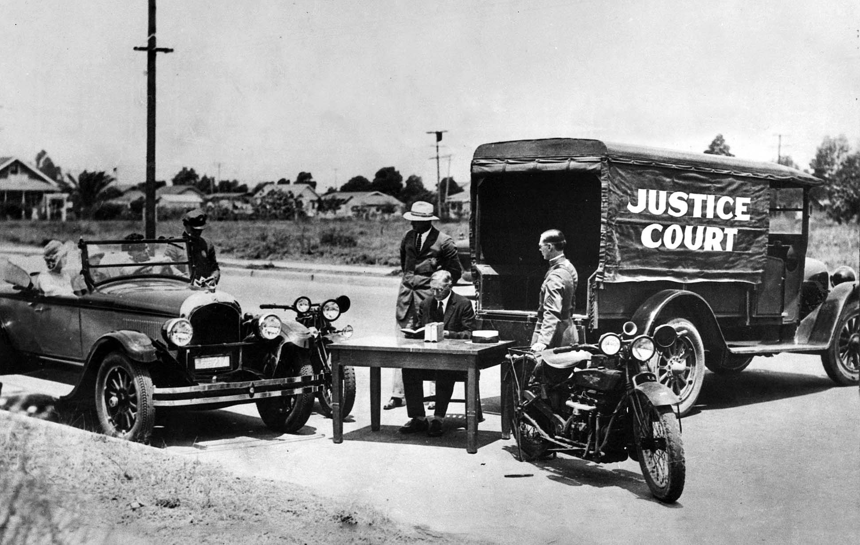
Early DUI Court

Slide 15
BLOOD TESTS
In 1938, based upon research by the American Medical Association and the National Safety Council, 0.15 percent became the first commonly-used legal limit for blood alcohol concentration (BAC).

Slide 16
BREATH TESTING

Slide 17
In 1936, Dr. Rolla N. Harger, an Indiana University professor of toxicology and biochemistry obtained a patent for his “Drunkometer”.

Slide 18
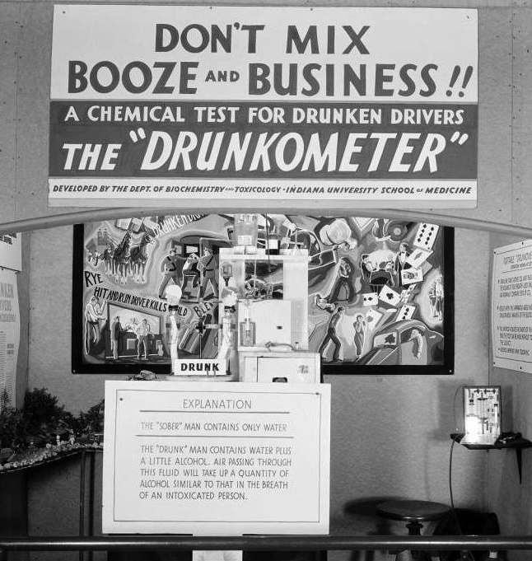
DRUNKOMETER

Slide 19
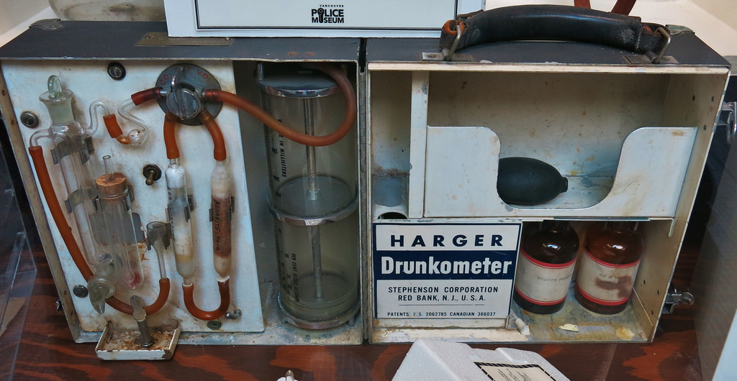

Slide 20
In 1953, Robert Borkenstein, a university professor & former police captain, invented the “Breathalyzer”. This machine used chemical oxidation and photometry to determine alcohol concentration.

Slide 21
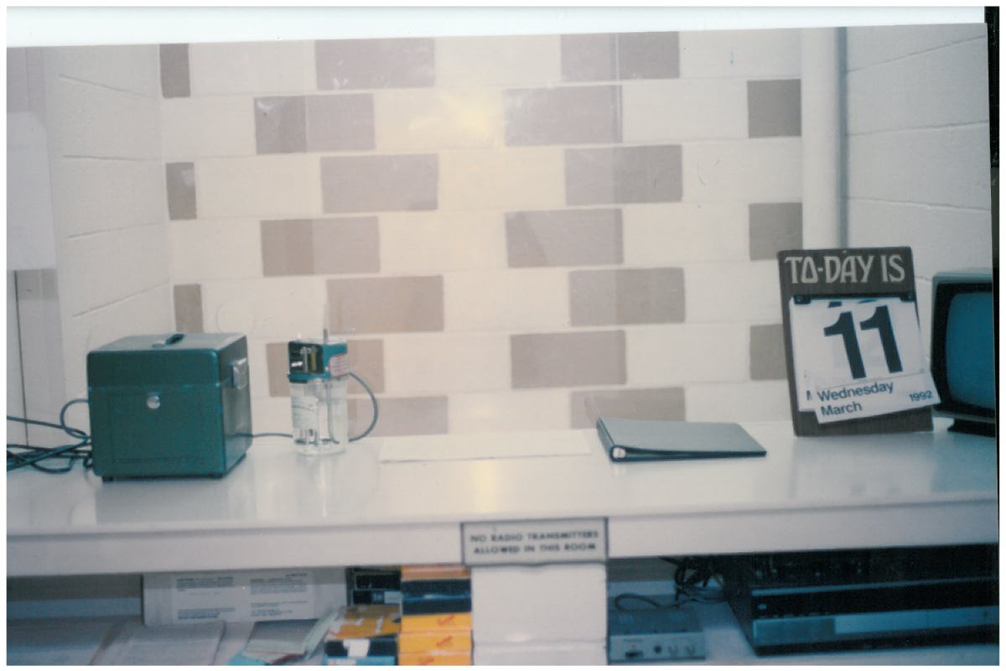
1992 Breathalyzer Room

Slide 22
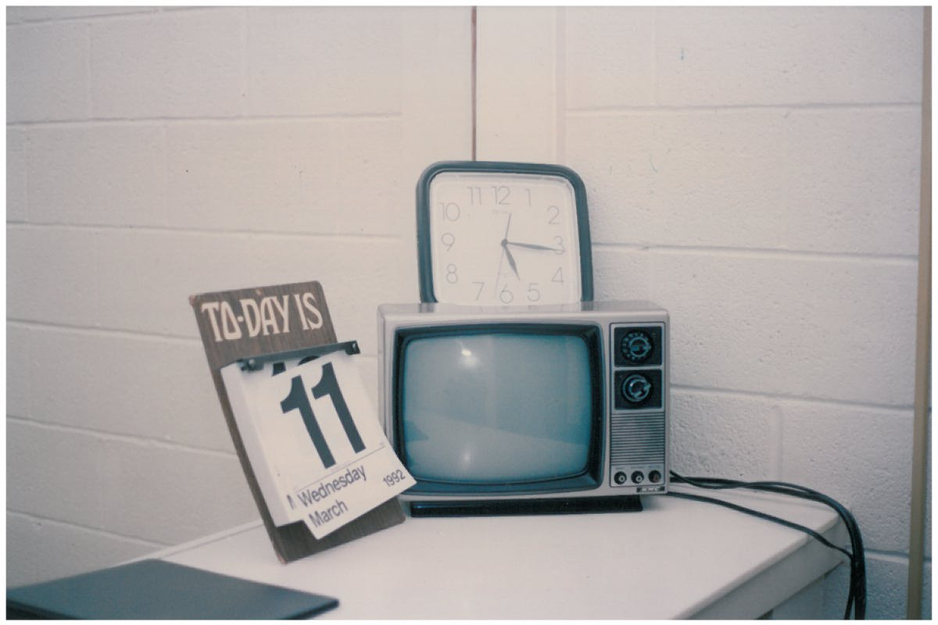

Slide 23
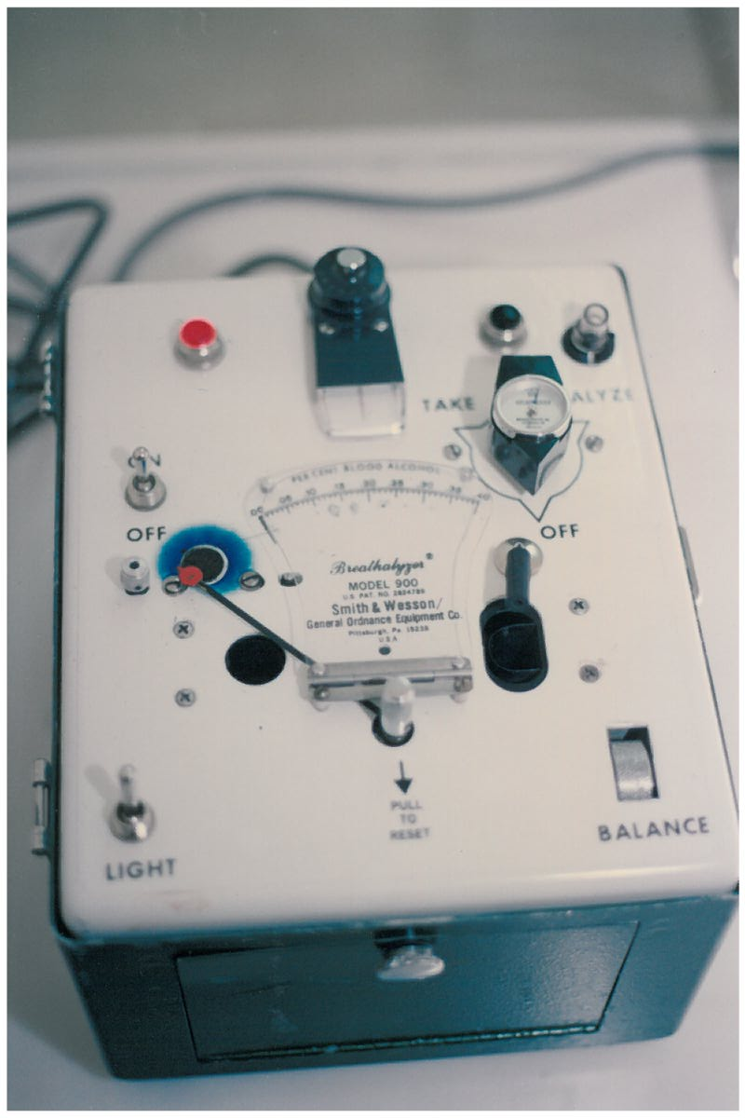
Breathalyzer S&W 900

Slide 24
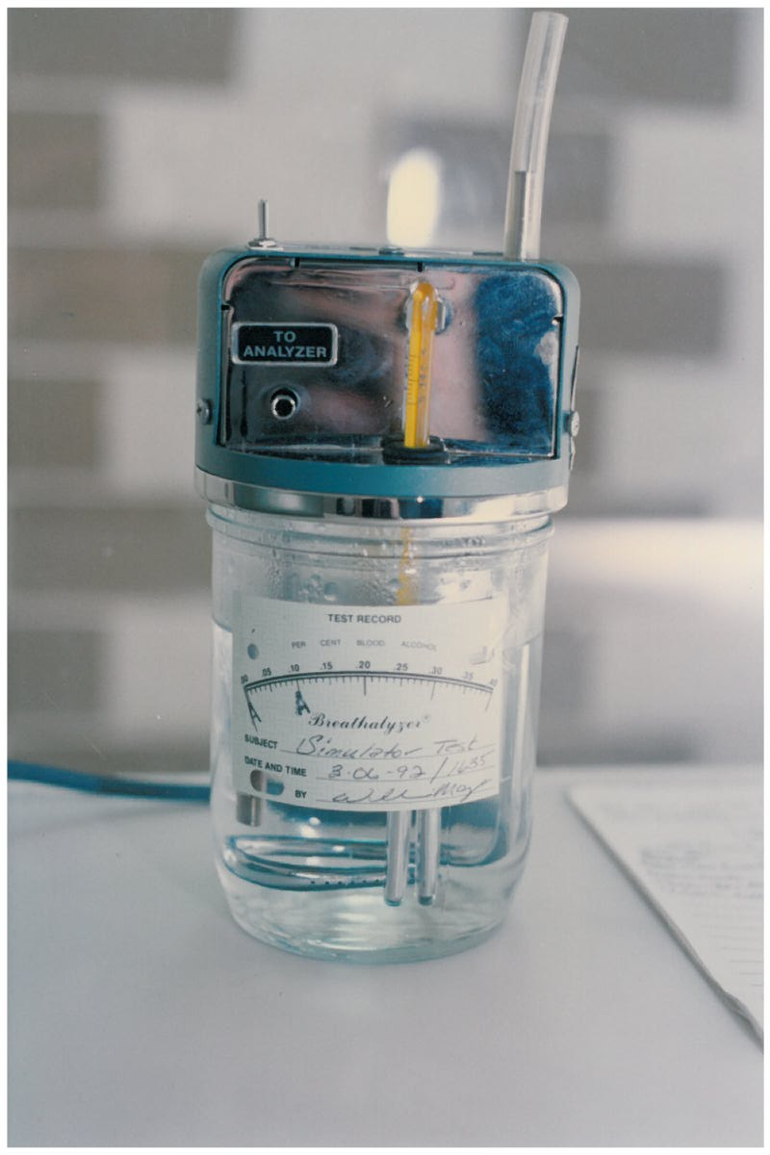
Simulator Solution Bottle

Slide 25
National Minimum Drinking Age
In 1984, The National Minimum Drinking Age Act became law. It required states to pass individual legislation raising the drinking age to 21.

Slide 26
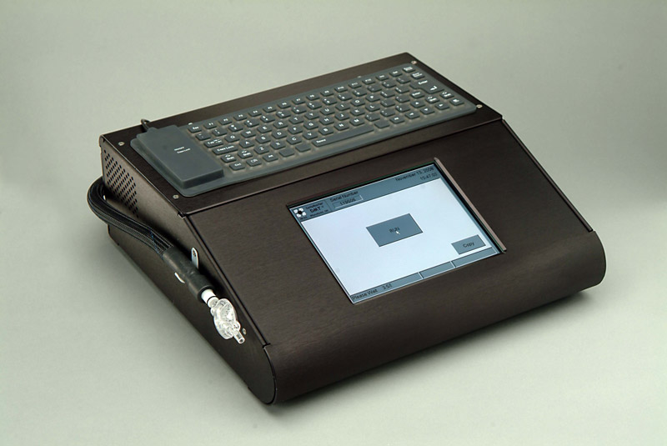
Infrared Testing
DATAMASTER

Slide 27
NATIONAL INFERENCE LEVEL
In 2000, Congress adopted .08 BAC as the national illegal limit for impaired driving.

Slide 28
STADARDIZED FIELD SOBRIETY TESTS

Slide 29
NHTSA Tests
In 1975, the National Highway Traffic Safety Administration (NHTSA) commissioned the Southern California Research Institute to evaluate the field sobriety tests most commonly used by law enforcement agencies around the country.

Slide 30
3 APPROVED TESTS
Horizontal Gaze Nystagmus
Walk and Turn
Heel To Toe

Slide 32
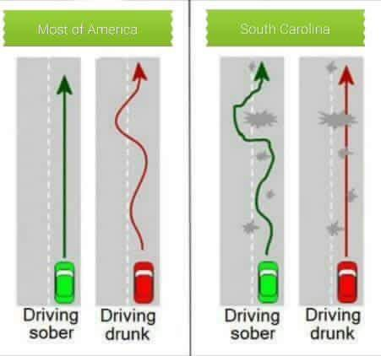
SC DUI “Vehicle In Motion”

Slide 33
LIGHTS, CAMERA, ACTION!

Slide 34
Videotaping

Slide 35
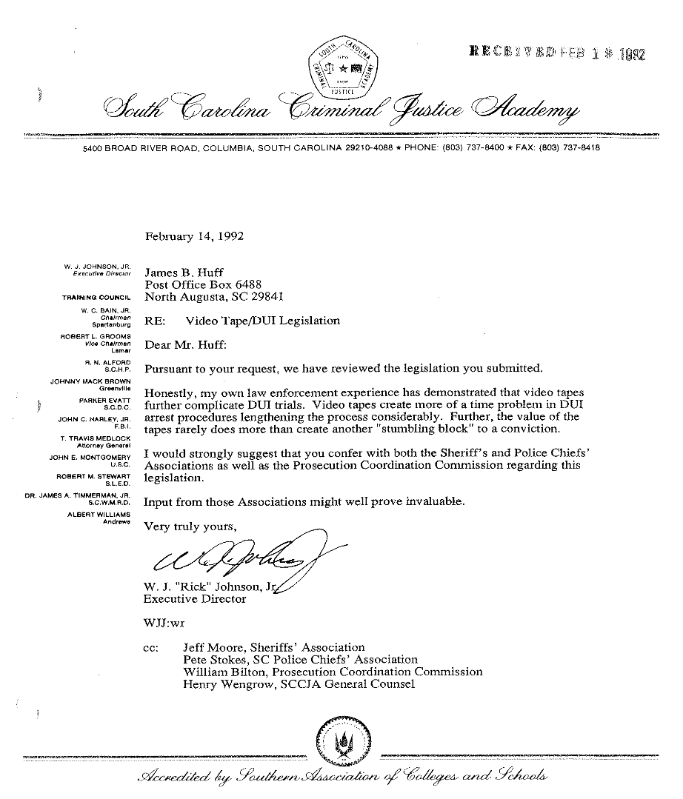

Slide 36
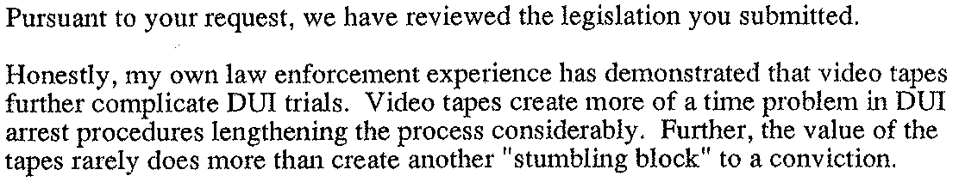

Slide 37
1996
South Carolina is the only state to have a mandatory DUI videotaping statute!

Slide 38
2024
South Carolina is the only state to have a mandatory DUI videotaping statute!

Slide 39
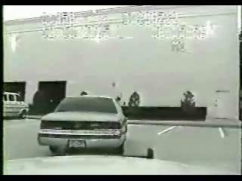
WHY POLICE DID NOT WANT VIDEOS

Slide 40
HOW WE WORK WITH JUDGES & SOLICITORS

Slide 41
RULE 3.3: CANDOR TOWARD THE TRIBUNAL
(a) A lawyer shall not knowingly:
(1) make a false statement of fact or law to a tribunal or fail to correct …(such a statement) made by the lawyer
(2) fail to disclose . . . legal authority in the controlling jurisdiction known to . . . be directly adverse to the position of the client and not disclosed by opposing counsel; or

Slide 42
(3) offer evidence that the lawyer knows to be false. If a lawyer, . . . client, or a witness called by the lawyer, has offered material evidence and the lawyer comes to know of its falsity, the lawyer shall take reasonable remedial measures, including, . . . disclosure to the tribunal.

Slide 43
RULE 3.4: FAIRNESS TO OPPOSING PARTY AND COUNSEL
A lawyer shall not:
(a) unlawfully obstruct another party's access to evidence . . .
(f) request a person other than a client to refrain from voluntarily giving relevant information to another party . . .

Slide 44
RULE 3.8: SPECIAL RESPONSIBILITIES OF A PROSECUTOR
The prosecutor in a criminal case shall:
(d) make timely disclosure to the defense of all evidence or information . . .
(f) except for statements that are necessary to inform the public of the nature and extent of the prosecutor's action . . ., refrain from making extrajudicial comments that have a substantial likelihood of heightening public condemnation of the accused . . .

Slide 45
ATTORNEYS OATH
I will maintain the respect and courtesy due to courts of justice, judicial officers, and those who assist them;
To my clients, I pledge faithfulness, competence, diligence, good judgment and prompt communication;
To opposing parties and their counsel, I pledge fairness, integrity, and civility,
I will maintain the dignity of the legal system . . .

Slide 46
WHERE ARE WE HEADED?

Slide 47
IT DEPENDS ON YOUR
PURPOSE
CHARACTER
INTEGRITY
HONOR
EFFORT

