Slide 1
"Unveiling the Truth: Mobile Device Forensics in Death by Distribution Investigations."
Presented by: Anthony Gentile, Digital Forensic Analyst, Envista Forensics

Slide 2
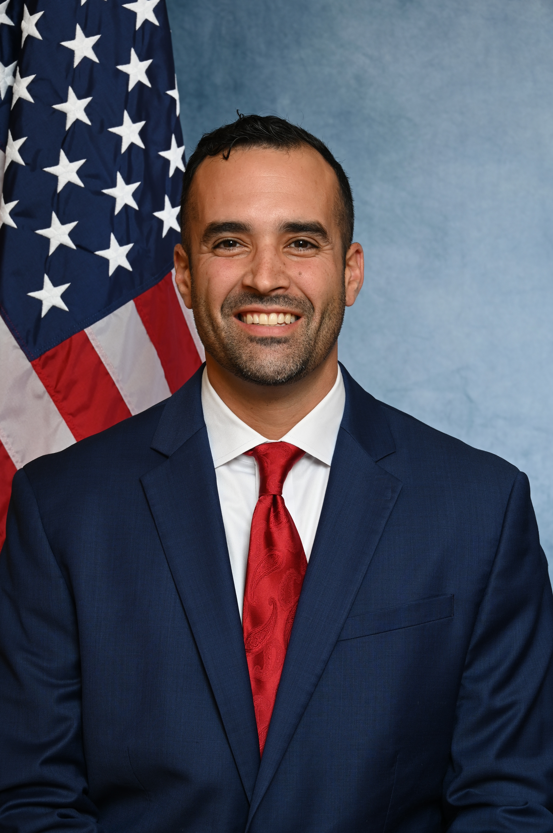
Anthony Gentile
Digital Forensic Analyst at Envista Forensics.
Qualified court expert in historical cell site analysis, call detail record analysis, and mobile device forensics.
Certified Cellebrite Operator (CCO), Cellebrite Certified Physical Analyst (CCPA).
Background in law enforcement from City of Columbia PD, Lexington County Sheriff’s Dept, SLED.
At SLED I conducted historical and live cellular analysis to locate fugitives and missing persons.
Received training from FBI Cellular Analysis Survey Team (CAST).

Slide 3
Cell Phone Extraction Evidence
Case Study – Death By Distribution
Questions
Notes:
Raise your hand if you have a case that involves a cell phone… Just about everyone, right? A cell phone extraction or cell phone records are involved in just about every case now.

Slide 4

Seeing the Full Picture
Looking through a window you can see the landscape.
The color of the flowers.
The wind blowing the leaves.
The green grass.
Step through that window and experience more.
You can smell the flowers.
You can feel the wind blowing in your hair.
You can smell the wet grass from the morning dew.
I will show you how we can add content to create context by examining cell phone extraction data.

Slide 5
Cell Phone Extraction Evidence
Encryption Types
Extraction Types
Report Vs. Original Data
Locked Devices

Slide 6


Encryption Types – Extractions
Full Disc Encryption (FDE)
“The key to the vault”
File Based
Encryption (FBE)
“We may have the key to the vault, but what about all the security boxes”
Notes:
This determines your extraction type.

Slide 7
Extraction Types
In order of preference for comprehensive collection:
Physical Extraction (Full-Disk Encrypted Devices)
Full File System Extraction (File Based Encrypted Devices)
Advanced Logical Extraction (Combination extraction including Partial File System and Logical methods)
Partial File System Extraction
Logical Extraction
Manual Extraction (Only relied on in certain circumstances and is not preferred.)
Manual extraction can cause data loss.

Slide 8
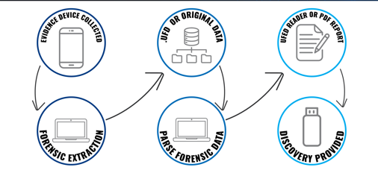
Extraction Report vs. Original Data
Notes:
The UFED reader is the final two steps you are missing the other portion of the data. The .ufd file is the original data files. That is examined by analyst. The report is generated by the analyst. They often differ by several GB in size showing that you are missing data. Usually 20% difference in data.

Slide 9
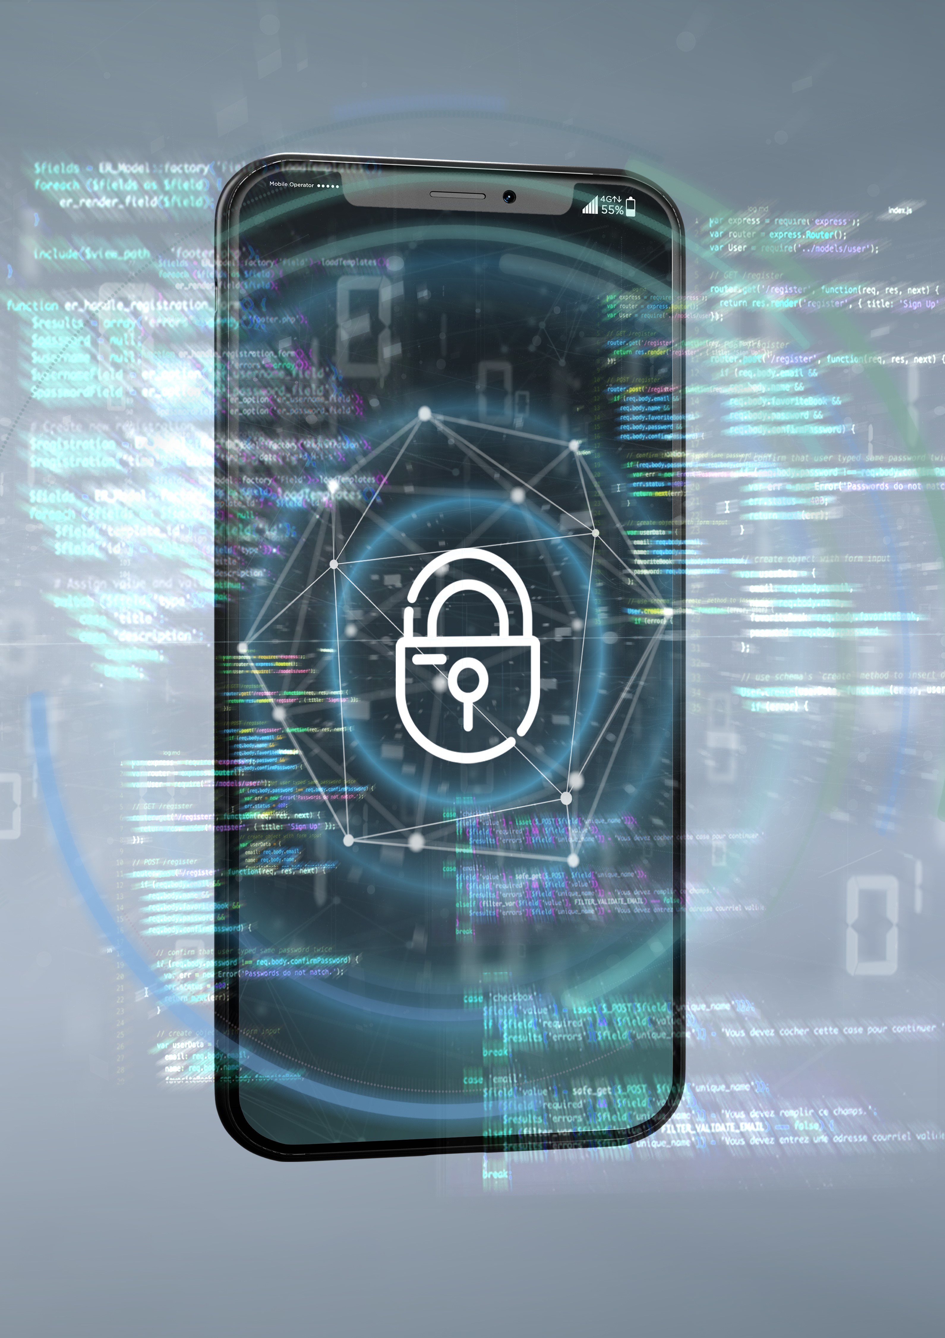
Locked Devices
Can we unlock locked phones?
Make, model, iOS
Settings / General / About
How long does it take?
Notes:
We would likely have a locked phone for the following reasons: deceased user, suicide, victim, forgotten.

Slide 10
Case Study
Death by Distribution Case Background:
Victim is a 22 year old white male who overdosed on heroine.
Police received his unlocked cell phone from his parents on scene.
Victim’s girlfriend tells police he was with the defendant the night before and was acting high.
She woke up and he was unresponsive on the balcony with a needle in his arm.

Slide 11
Positions and Assumptions
Prosecution
Defense
The defendant was a cold-hearted drug dealer.
He was making money dealing drugs.
He knew that the drugs contained lethal levels of fentanyl and sold them anyways.
He was the sole supplier of drugs to the victim.
The victim left his house after receiving the drugs and died shortly after.
They were coworkers and friends.
The defendant was not a drug dealer and only a casual user.
The defendant shared drugs that he purchased to use with the victim, he did not sell them to the victim.
The victim was addicted to drugs and had been in rehab.
The victim recently lost his job due to a failed drug test.
The victim solicited drugs from multiple people.
The victim died over 24 hours after leaving the defendant’s house.

Slide 12
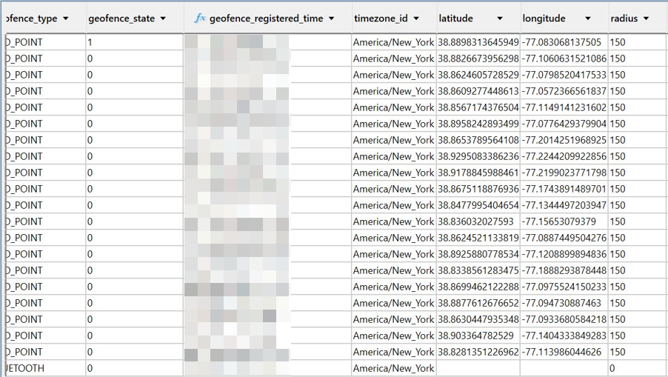
Location Data
Shows locations generated by source with date/time, latitude / longitude, and display radius.
Searched, metadata, mapped, Wi-Fi survey.
Notes:
Just because you see a latitude / longitude it does not mean that the location is from GPS services. Wi-Fi emitters, multiple satellites. Also, all GPS coordinates are not equal. Check for a “radius” which is measured in meters.

Slide 13
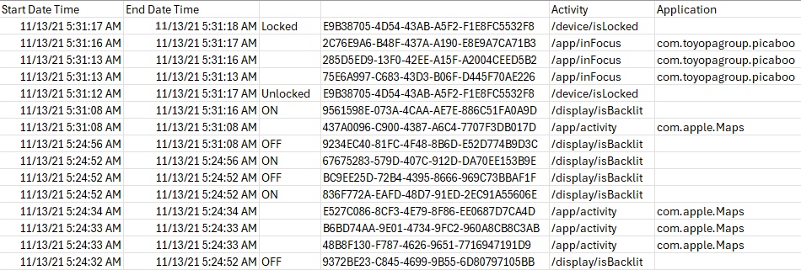
Knowledge C Data
Database stores an event log of processes in Apple phones.
Tells a story and helps create a timeline.
Notes:
Here we see the time the phone was locked, unlocked, snapchat usage, apple maps, backlit on and off. This tells us when he last used his phone and gives us a better time of death in this case.

Slide 14
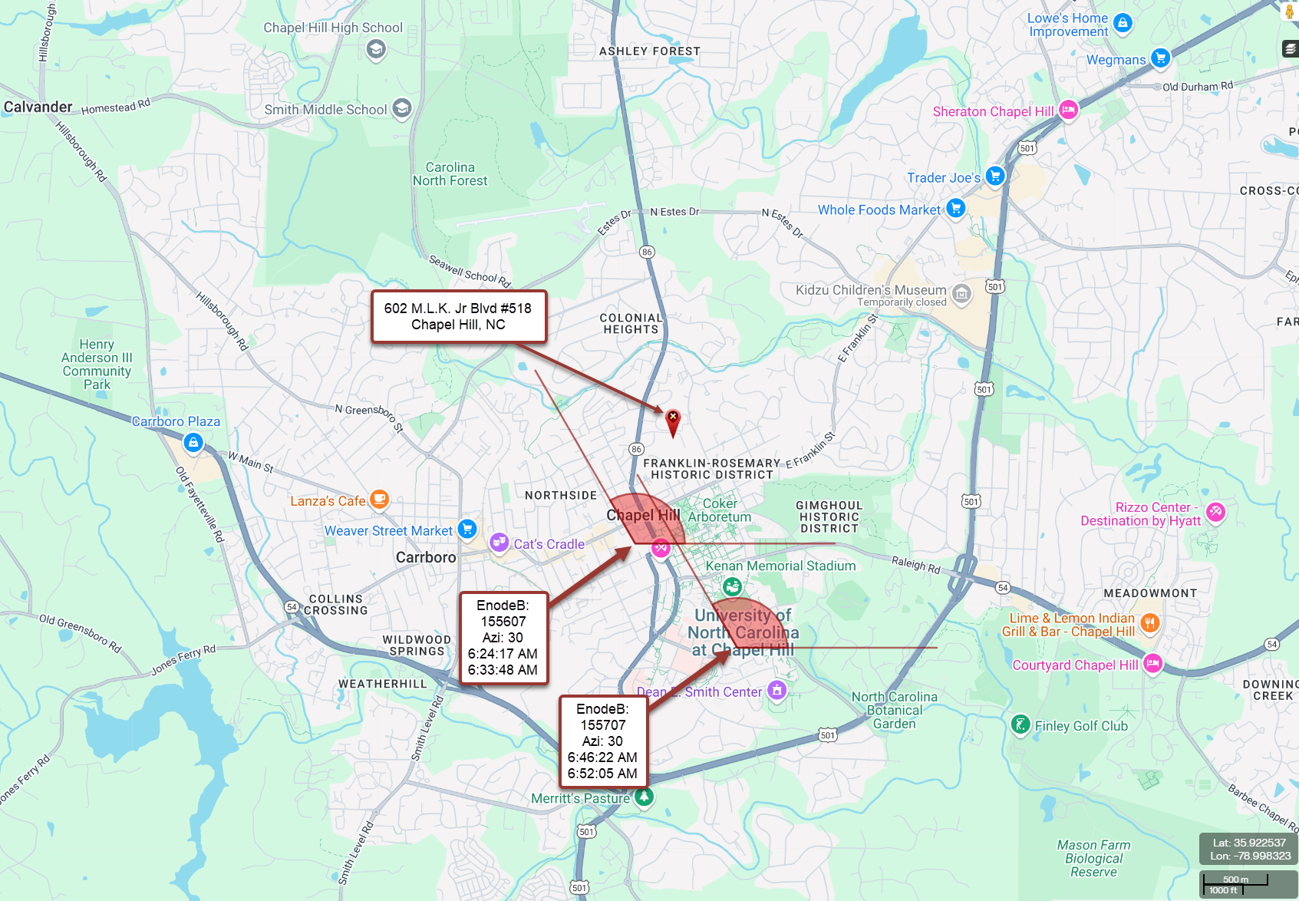
Call Detail Records (CDR) for Cell Site Analysis
CDR provides general location information.
Limited to tower & sector.
Transaction initiated.
Pitfalls –
Mapping data sessions
Size of sectors
Assuming coverage of towers
Mapping select transactions
Making claims of precision

Slide 15
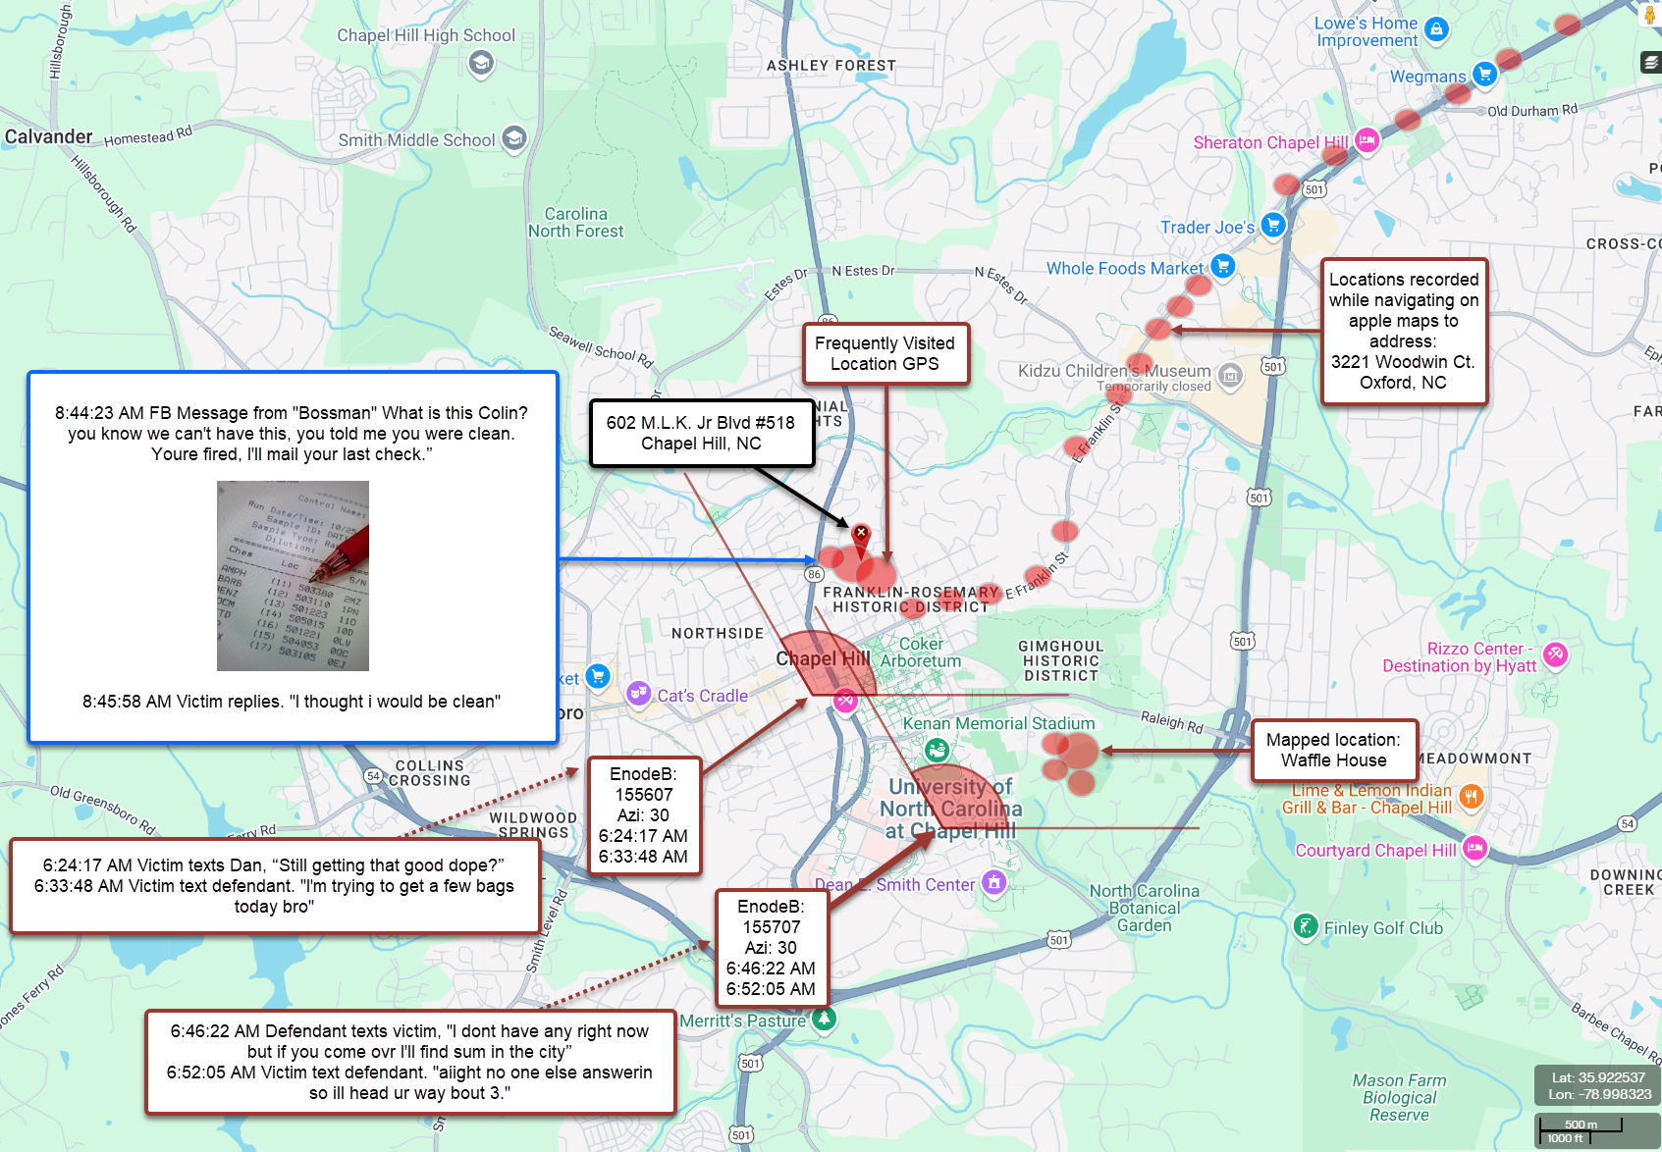
CDR with Extraction Data – Content for Context
Transactions include content. Shows deleted messages.
GPS location events – Mapped, Frequented, Searched.
Social media message content.
Providers do not store message content (VZW 7 days).
Social media content requires separate legal process
Notes:
Here we see that the transactions are text messages that show him looking for drugs from others. The def. saying he will find drugs for him. FB Message shows he was an avid user. GPS shows where he navigated to.

Slide 16
In Conclusion – So What?
Cell phones are a part of every case.
Content provides context.
Report vs. Original Data – Do you have all of the data?
What are the limits of the technology?
Consultation on cross examination questions.
Know what is coming before late disclosure.
I am your local expert with experience.

Slide 17
Anthony.Gentile@EnvistaForensics.com
803-995-0882

