Slide 1
MOTION PRACTICE IN DUI CASES
Dayne Phillips

Slide 2
WHY FILE AND ARGUE MOTIONS?
Winners vs. losers
Expose / Create weaknesses in the State’s case.
Aid negotiations with the Prosecutor.

Slide 3
WHY FILE AND ARGUE MOTIONS?
Ensure the accused’s right to Due Process, effective assistance of counsel, and preserve issues for appellate review.
Make chicken salad out of . . . .
Builds trust with your Client.

Slide 4


Slide 5
HOW TO FILE AND ARGUE MOTIONS
Read the applicable statute(s) and case law.
List the applicable issues to your facts.
Discuss with your colleagues

Slide 6
HOW TO FILE AND ARGUE MOTIONS
Mark and admit the written motions as Exhibits during the hearing.
Provide copies to Judge, Opposing Counsel, Court Reporter.
Believe in your arguments – Passionate argument is a persuasive argument

Slide 7
ALWAYS CITE APPLICABLE LAW 1
Provide the trial court with the applicable
Federal and state constitutional provisions
Statutory provisions in the S.C. Code of Laws
SC Rules of Evidence, Criminal Procedure, Professional Conduct, & Appellate Court Rules
Necessary for appellate review.

Slide 8
ALWAYS CITE APPLICABLE LAW 2
Must make specific arguments and cite relevant law to preserve the issues for appellate review.
U.S. Const. amends V, VI, XIV
S.C. art. I, §§§ 3, 10, and 14
S.C. Code § 17-23-60
Miranda v. Arizona, 384 U.S. 436 (1966)

Slide 9
FEDERAL & STATE CONSTITUTIONAL GROUNDS
You should always provide the trial court with federal and state constitutional grounds when objecting (even if they overlap).
For example, “I move to suppress the evidence under the Four and Fourteenth Amendments to the United States Constitution, and Article I, Section 10 of the South Carolina Constitution because the evidence was obtained based on an illegal search and seizure.” Then apply the law to the facts of your case.
NOTE: South Carolina Constitution provides greater protection for unreasonable invasions of privacy. See State v. Counts

Slide 10
DUI STATUTES
§ 56-5-2930 (Operating Motor Vehicle UTI)
§ 56-5-2953 (IS and BTS Video Recordings)
§ 56-5-2945 (Felony DUI – Death and GBI)
§ 56-5-2946 (Submission to Testing)
§ 56-5-2950 (Implied Consent to Testing)
§ 56-5-2933 (DUAC)

Slide 11
RULE 4, SCRCrimP
(a) Form of Motions. An application to the court for an order shall be by motion which, unless made during a hearing or trial in open court with a court reporter present, shall be made in writing, shall state with particularity the grounds therefor, and shall set forth the relief or order sought. The requirement of writing is fulfilled if the motion is stated in a written notice of the hearing of the motion.

Slide 12
RULE 4, SCRCrimP
(b) Subsequent Applications for Order After Refusal. If any motion be made to any judge and be denied, in whole or in part, or be granted conditionally, no subsequent motion upon the same set of facts shall be made to any other judge in that action. If upon such subsequent motion any order be made, it shall be void.

Slide 13
IMPORTANT POINTS 1
No limit to the number of motions you can argue (non-frivolous).
Eliminate legalese and unnecessary language.
Argue main point & requested relief quickly.

Slide 14
IMPORTANT POINTS 2
Put Judge and Solicitor on notice that you are prepared.
Slow and Confident: The judge (and court reporter) need understand your arguments.
Need thick skin – cannot thrive on validation

Slide 15
FOUR ELEMENTS OF ISSUE PRESERVATION
There are four basic requirements to preserving issues at trial for appellate review. The issue must have been
(1) raised to and ruled upon by the trial court,
(2) raised by the Appellant,
(3) raised in a timely manner, and
(4) raised to the trial court with sufficient specificity.

Slide 16
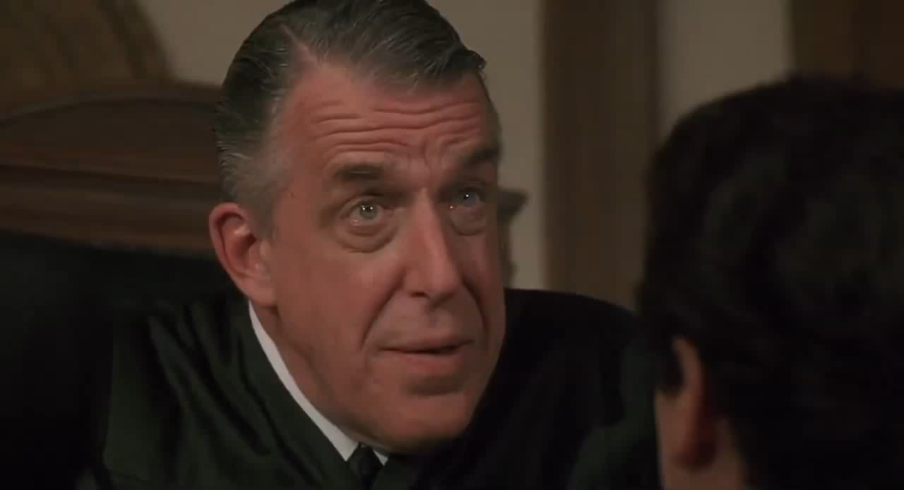

Slide 17
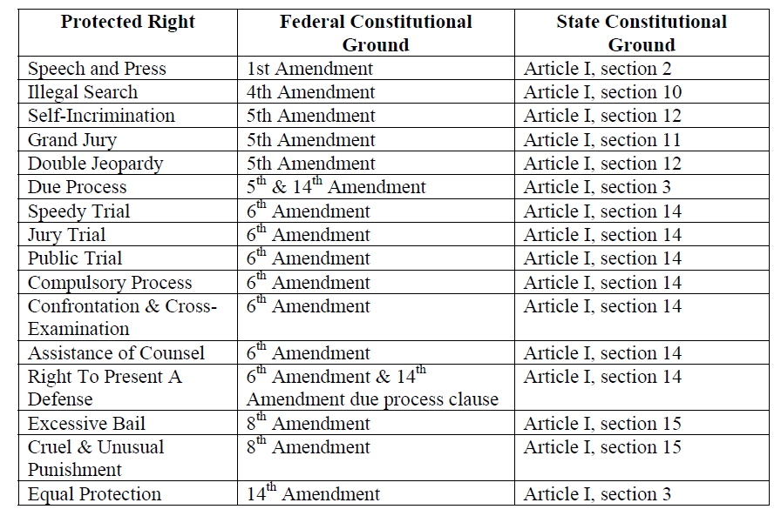

Slide 18
PRE-TRIAL MOTIONS
Discovery Issues
Jury Selection
Sequestration of Witnesses
Amend Indictment
Severance / Elect
Motions In Limine
Suppression
Admissibility of Evidence

Slide 19
TRIAL MOTIONS
Confrontation Issues
Competency of a Witness
Curative Instruction
Directed Verdict
Compel Attendance of a Witness
Jury Instructions
Allen Charge

Slide 20
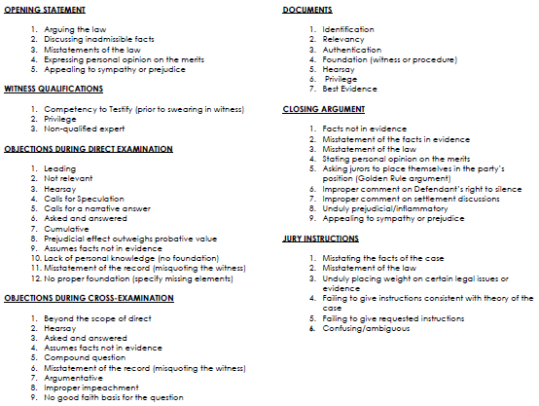

Slide 21
POST-TRIAL MOTIONS
Polling the Jury
New Trial – Rule 29, SCRCrimP
Pre-sentencing Report and Affidavits
Reconsideration of the Sentence
Notice of Intent to Appeal
Appeal Bond

Slide 22
MOTIONS FOR DISCOVERY
Motion for Discovery, Disclosure and Inspection of Evidence
Supplemental Motion for Discovery
Motion to Compel
Motion to Inspect, Examine, and Test Evidence
Motion to View the Scene

Slide 23
SUPPLEMENTAL MOTION FOR DISCOVERY
Two reasons: (1) Non-compliance with initial discovery request, or
(2) Specific requests for discovery.
Constitutional right to Present a Complete Defense (i.e., information is necessary to prepare a defense).

Slide 24
MOTION TO COMPEL DISCOVERY
Request a hearing if you have not received discovery after filing the initial and supplemental motions for discovery.
Move for the Court to order the State to produce the requested discovery.

Slide 25
MOTION TO INSPECT, EXAMINE, & TEST EVIDENCE
Scientific evidence
Independent testing by an expert witness
Physical evidence
Personal observation could help you argue for or against it at trial.

Slide 26
MOTION FOR CONTINUANCE: RULE 7, SCRCRIMP
Not for purposes of delay, but necessary to preserve the defendant’s constitutional rights.
State v. Tanner, 299 S.C. 459, 385 S.E.2d 832 (1989) (Continuance should be granted when the State fails to disclose evidence until the eve of trial, and the defendant shows that testing the new evidence has exculpatory value.

Slide 27
MOTION TO QUASH WARRANT/INDICTMENT
Must be done before the jury is sworn
S.C. Const. art. I, § 11
S.C. Code §§ 17-19-10 and 90
State v. Gentry, 363 S.C. 93, 610 S.E.2d 494 (2005) (notice document).

Slide 28
MOTIONS TO DISMISS
Unlawful arrest
Quash Indictment
Discovery violation
Pre-indictment delay
Speedy Trial
Failure to Prosecute
Spoliation of Evidence

Slide 29
UNLAWFUL ARREST
Arrest must be supported by probable cause.
Tennessee v. Garner, 471 U.S. 1 (1985)
Gerstein v. Pugh, 420 U.S. 103 (1975)

Slide 30
SEARCH AND SEIZURE ISSUES
S.C. Const. Art. I, § 10.
Warrantless Searches vs. Search Warrants
Unlawful detention
Wong Sun v. United States, 371 U.S. 471, 484 (1963)
Mapp v. Ohio, 367 U.S. 643 (1961)

Slide 31
CORPUS DELICTI DUI

Slide 32
DUI: ELEMENTS OF THE OFFENSE
The corpus delicti of (DUI):
Driving
Motor vehicle;
(3) Within this state;
(4) While under the influence of alcohol/drugs;
(5) To the extent that the person’s faculties to drive are materially and appreciably impaired.

Slide 33
CORPUS DELICTI: DRIVING
State v. Graves, 269 S.C. 356, 237 S.E.2d 584 (1997)
Term “driving” is given stricter construction than term “operating”; to be guilty of driving vehicle while intoxicated defendant must have had vehicle in motion at time in question, while operating has been more liberally construed to include starting engine or manipulating mechanical or electrical agencies of vehicle.

Slide 34
CORPUS DELICTI: DRIVING
State v. Graves, 269 S.C. 356, 237 S.E.2d 584 (1997)
Respondent was not driving vehicle within meaning of § 56-5-2930 where found by highway patrol officer in automobile with engine running and transmission in gear, since there was no showing by direct or circumstantial evidence that respondent had placed vehicle in motion while under influence of intoxicants.

Slide 35
CORPUS DELICTI: DRIVING
State v. Graves, 269 S.C. 356, 237 S.E.2d 584 (1997)
Word “drive” under § 56-5-2930 requires vehicle be in motion to constitute offense, as shown by either direct or circumstantial evidence.

Slide 36
CORPUS DELICTI: STATEMENTS
State v. Smith, 328 S.C. 622, 493 S.E.2d 506 (Ct. App. 1997)
To sustain driving (DUI) conviction, there must be evidence, other than defendant’s extra-judicial statements, that someone, but not necessarily defendant, was driving while impaired.

Slide 37
CORPUS DELICTI: STATEMENTS
Anderson v. State, 442 S.C. 372, 898 S.E.2d 218 (Ct. App. 2024)
Defendant's admission in encounter with deputy and trooper that he had been driving and that he was drunk was corroborated by substantial independent evidence, so as to satisfy corpus delicti rule.

Slide 38
CORPUS DELICTI: STATEMENTS
Anderson v. State, 442 S.C. 372, 898 S.E.2d 218 (Ct. App. 2024)
Officer responded to a private residence in Greenwood County after someone reported a suspicious vehicle in the driveway. The private residence was not Anderson's home.
Officer discovered Anderson passed out in the driver's seat with his foot on the brake, while the vehicle's engine was running with the transmission in drive.

Slide 39
CORPUS DELICTI: STATEMENTS
Anderson v. State, 442 S.C. 372, 898 S.E.2d 218 (Ct. App. 2024)
“the corroboration rule is satisfied if the State provides sufficient independent evidence which serves to corroborate the defendant's extra-judicial statements and, together with such statements, permits a reasonable belief that the crime occurred.”
“the corroborative evidence need not be sufficient, independent of the statements, to establish the corpus delicti.”

Slide 40
CORPUS DELICTI: STATEMENTS
Anderson v. State, 442 S.C. 372, 898 S.E.2d 218 (Ct. App. 2024)
We acknowledge that at first blush, the facts of the present case may seem similar to those in Graves. However, the defendant in Graves never admitted to driving the vehicle *382 as Anderson did here.

Slide 41
CORPUS DELICTI: CONFESSION
State v. McCombs, 335 S.C. 123, 515 S.E.2d 547 (Ct. App. 1999)
Proof of corpus delicti is not a prerequisite to the admission of an extra-judicial confession of a defendant; rather,
If the state fails to prove the corpus delicti and the sole evidence of guilt is the defendant’s confession, then a directed verdict in favor of the defendant is required.

Slide 42
CORPUS DELICTI: UNDER THE INFLUENCE
Kennedy v. Griffin, 358 S.C. 122, 595 S.E.2d 248 (Ct. App. 2004)
A driver is “under the influence,” for purposes of statute stating that it is unlawful to drive while under the influence of alcohol or drugs, when ingestion of drugs or alcohol results in the impairment of the driver’s faculties, impairs the driver’s ability to operate the vehicle with reasonable care, or impairs the driver’s ability to drive as a prudent driver would operate the vehicle.

Slide 43
CORPUS DELICTI: UNDER THE INFLUENCE
State v. Kerr, 330 S.C. 132, 498 S.E.2d 212 (Ct. App. 1998)
Motorist is “under the influence” when ingestion of one or more of substances listed in relevant statute has resulted in impairment of his faculties.

Slide 44
CORPUS DELICTI: UNDER THE INFLUENCE
State v. Kerr, 330 S.C. 132, 498 S.E.2d 212 (Ct. App. 1998)
One violates driving under influence statute if he partakes of alcohol to extent that he cannot drive motor vehicle with reasonable care, or if he cannot drive as prudent driver would operate vehicle.

Slide 45
DEFENDANT’S STATEMENTS

Slide 46
CUSTODIAL INTERROGATION: MIRANDA
State v. Lowery, 443 S.C. 473, 905 S.E.2d 361 (2024)
State had burden of proof on issues of custodial interrogation under Miranda
Preponderance of the evidence

Slide 47
LOWERY: NOT A ROUTINE TRAFFIC STOP
State v. Lowery, 443 S.C. 473, 905 S.E.2d 361 (2024)
Scenario in which officers begin looking for an individual after being told a driver left the scene does not typically constitute a routine traffic stop. (Targeted Investigation)

Slide 48
LOWERY: INCRIMINATING RESPONSES
State v. Lowery, 443 S.C. 473, 905 S.E.2d 361 (2024)
During the first thirty-three seconds of the video, Trooper Vallin, without Mirandizing Lowery, questioned Lowery as to where he had been before arriving at the Spinx parking lot and how Lowery was able to drive with a flat tire.
These questions were “interrogation,” as they were reasonably likely to elicit incriminating responses.

Slide 49
MIRANDA WARNINGS REQUIRED 1
State v. Medley, 417 S.C. 18, 787 S.E.2d 847 (Ct. App. 2016)
Defendant was subject to custodial interrogation at the time he made the initial incriminating statement regarding his alcohol consumption, and thus, Miranda warnings were required;
Defendant's incriminating statements, that he made in patrol car on way to detention center, were not direct product of the impermissible tactic of “question first, give Miranda rights later;” and
Court's error in admitting defendant's custodial statements regarding his alcohol consumption, which were made prior to receiving Miranda warnings, was harmless.

Slide 50
MIRANDA WARNINGS REQUIRED 2
Defendant was subject to custodial interrogation at the time he made the initial incriminating statement regarding his alcohol consumption,
Defendant was in his parents’ front yard, officer had him handcuffed and pinned to the ground while asking the question that elicited the objectionable response and
given that the most important factual question in any DUI case was how much alcohol the suspect consumed prior to getting behind wheel, officer should have known his question was reasonably likely to elicit an incriminating response from defendant.

Slide 51
MIRANDA WARNINGS REQUIRED 3
Officer’s asking defendant how much he had to drink was irrelevant to the public’s safety, and
thus, officer’s question did not fall within the public safety exception to Miranda;
only purpose for asking such a question was to obtain evidence for DUI case.

Slide 52
STATEMENT: DRIVING
State v. Russell, 345 S.C. 128, 546 S.E.2d 202 (Ct. App. 2001)
In prosecution for (DUI), defendant’s extra-judicial statements to police that he was driving were admissible to establish corpus delicti,
as they were sufficiently corroborated by independent facts that he owned the car, that he was the only one present when police arrived, that the ignition key was in his pocket, and that the hood of the car was still warm.

Slide 53
REFUSAL OF BREATH TEST
State v. Kerr, 330 S.C. 132, 498 S.E.2d 212 (1998)
Jury in prosecution for (DUI) could consider fact that defendant refused breath test as prosecutorial evidence against him.

Slide 54
SEARCH AND SEIZURE

Slide 55
WARRANTLESS SEARCH
Birchfield v. North Dakota, 136 S. Ct. 2160 (2016)
holding a warrantless breath test, but not a blood test, is valid as a lawful search incident to arrest

Slide 56
BLOOD DRAW: WARRANTLESS SEARCH
State v. German, 439 S.C. 449, 887 S.E.2d 912 (2023) (warrantless search based on 56-5-2946)
Implied consent statute requiring submission to chemical testing violated Fourth Amendment as applied
Implied consent statute did not facially violate Fourth Amendment.

Slide 57
BLOOD DRAW: WARRANTLESS SEARCH
State v. German, 439 S.C. 449, 887 S.E.2d 912 (2023) (warrantless search based on 56-5-2946)
Warrantless blood draw violated state constitutional right against unreasonable invasion of privacy
Results of warrantless blood draw came within good-faith exception to exclusionary rule

Slide 58
BLOOD DRAW: SEARCH WARRANT
Missouri v. McNeeley, 569 U.S. 141 (2013)
In drunk-driving investigations where police officers can reasonably obtain a warrant before a blood sample can be drawn without significantly undermining the efficacy of the search, the Fourth Amendment mandates that they do so.

Slide 59
BLOOD DRAW: SEARCH WARRANT
Missouri v. McNeeley, 569 U.S. 141 (2013)
The natural metabolization of alcohol in the bloodstream does not present a per se exigency that justifies an exception to the Fourth Amendment’s search warrant requirement for nonconsensual blood testing in all drunk-driving cases, and instead, exigency in this context must be determined case-by-case based on the totality of the circumstances

Slide 60
BLOOD DRAW: SEARCH WARRANT
Missouri v. McNeeley, 569 U.S. 141 (2013)
Factors present in an ordinary traffic stop of a suspected drunk driver, such as the procedures in place for obtaining a search warrant or the availability of a magistrate judge, may affect whether the police can obtain a search warrant in an expeditious way and therefore may establish an exigency that permits a warrantless blood draw.

Slide 61
BLOOD DRAW: WARRANTLESS SEARCH
State v. McCall, 429 S.C. 404, 839 S.E.2d 91 (2020)
Exigent circumstances existed justifying warrantless blood draw under Fourth Amendment of (DUI) suspect involved in serious traffic accident that occurred during evening rush hour; obtaining a warrant was not practical under the circumstances given indication that it would have taken at least 90 minutes to obtain a warrant, and law enforcement officers believed that suspect was impaired by a substance other than alcohol that could quickly dissipate.

Slide 62
BLOOD DRAW: WARRANTLESS SEARCH
State v. Key, 431 S.C. 336, 848 S.E.2d 315 (2020)
While the State’s appeal was pending in this Court, the United States Supreme Court decided Mitchell v. Wisconsin, 139 S. Ct. 2525 (2019).
In Mitchell, the Supreme Court held for the first time that, generally, law enforcement is permitted to draw the blood of an unconscious DUI suspect without a search warrant pursuant to the exigent circumstances exception to the warrant requirement.
However, the Supreme Court acknowledged the possibility of an “unusual” case presenting an exception to this new general rule. The Mitchell Court determined the defendant should be given the opportunity to establish the applicability of the exception to the general rule and remanded the case to the trial court for that purpose.

Slide 63
BLOOD DRAW: WARRANTLESS SEARCH
State v. Key, 431 S.C. 336, 848 S.E.2d 315 (2020)
We have carefully considered the Mitchell holding and conclude we will not impose upon a defendant the burden of establishing the absence of exigent circumstances. We hold the burden of establishing the existence of exigent circumstances remains upon the State.

Slide 64
BLOOD DRAW: FELONY DUI
Hamrick v. State, 426 S.C. 638, 828 S.E.2d 596 (2019)
Trial court did not err in refusing to exclude blood test results based on police officers’ failure to draw defendant’s blood within three hours of his arrest, as required by statute, in prosecution for felony DUI resulting in great bodily injury, where failure to draw defendant’s blood within three hours of his arrest did not materially affect accuracy or reliability of test results or fairness of testing procedure, and there was no evidence the delay in drawing defendant’s blood resulted in anything but test result showing a lower blood alcohol concentration than would have been shown if the test were timely conducted.

Slide 65
ADMISSIBILITY OF EVIDENCE: Expert Testimony

Slide 66
RULE 701, SCRE LAY WITNESS TESTIMONY
Scope and Speculation:
Lay witnesses often testify outside the scope of their knowledge.

Slide 67
EXPERT TESTIMONY: RULE 702, SCRE
Before admitting expert testimony, trial courts, as the gatekeepers of evidence, must ensure the proffered evidence is beyond the ordinary knowledge of the jury; the witness has the skill, training, education, and experience required of an expert in his field; and the testimony is reliable.
Watson v. Ford Motor Co., 389 S.C. 434, 445–46, 699 S.E.2d 169, 174–75 (2010)

Slide 68
EXPERT TESTIMONY: VALID & RELIABLE
In South Carolina, a trial court minding the Rule 702 gate must assess not only (1) whether the expert’s method is reliable (i.e., valid), but also (2) whether the substance of the expert’s testimony is reliable.
See State v. Council, 335 S.C. 1, 20, 515 S.E.2d 508, 518 (1999)

Slide 69
EXPERT TESTIMONY
Four factors to be considered in determining the admissibility of novel scientific evidence: (1) publications and peer review; (2) prior application of the method to the type of evidence in the case; (3) quality control procedures utilized; and (4) consistency of the method with recognized scientific law and procedures.
State v. Jones, 273 S.C. 723, 730–32, 259 S.E.2d 120, 124–25 (1979)

Slide 70
EXPERT TESTIMONY: RELIABILITY
“The trial judge should apply the Jones factors to determine reliability.”
Council, 335 S.C. at 20, 515 S.E.2d at 518.
The substance of an expert’s testimony is reliable if it adheres to the rigors of the method.
Kumho Tire Co. v. Carmichael, 526 U.S. 137, 152, 119 S.Ct. 1167, 143 L.Ed.2d 238 (1999).

Slide 71
EXPERT TESTIMONY
South Carolina has not adopted Daubert v. Merrell Dow Pharmaceuticals, Inc., 509 U.S. 579, 594–95, 113 S.Ct. 2786, 125 L.Ed.2d 469 (1993), by name, nor has it revised Rule 702, SCRE, to incorporate the Daubert framework.
Nevertheless, our approach is “extraordinarily similar” to the federal test.

Slide 72
RULE 702, SCRE EXPERT TESTIMONY
Qualified?
Challenge the expert’s qualifications
Nail-down the specific area of expertise
Area and scope of Expertise:
Expert witnesses often testify outside the area and scope of their expertise.

Slide 73
SFSTs

Slide 74
SFSTs
Admissible only if conducted per NHTSA
2006 NHTSA manual,
“IT IS NECESSARY TO EMPHASIZE THIS VALIDATION APPLIES ONLY WHEN:
THE TESTS ARE ADMINISTERED IN THE PRESCRIBED, STANDARDIZED MANNER
THE STANDARDIZED CLUES ARE USED TO ASSESS THE SUSPECT’S PERFORMANCE
THE STANDARDIZED CRITERIA ARE EMPLOYED TO INTERPRET THAT PERFORMANCE
IF ANY ONE OF THE STANDARDIZED FIELD SOBRIETY ELEMENTS IS CHANGED THE VALIDITY IS COMPROMISED.”

Slide 75
VIDEO RECORDINGS

Slide 76
VIDEO RECORDING: MUST BEGIN
State v. Henkel, 413 S.C. 9, 774 S.E.2d 458 (2015)
Compliance with statute requiring videotaping at incident site during an arrest for (DUI) must begin at the time videotaping becomes practicable and continue until the arrest is complete.
Officer's failure to videotape administration of Miranda warnings, which occurred prior to time at which videorecording became practicable, did not require dismissal of indictment under statute.

Slide 77
VIDEO RECORDING: FAILURE TO COMPLY
State v. Johnson, 408 S.C. 544, 758 S.E.2d 911 (Ct. App. 2014)
The failure to comply with the video recording requirements for traffic stops merits a per se dismissal of a charge for (DUI).

Slide 78
VIDEO RECORDING: FAILURE TO COMPLY
Town of Mt. Pleasant v. Roberts, 393 S.C. 332, 713 S.E.2d 278 (2011)
Unexcused failure to video record defendant’s conduct in a traffic stop underlying a prosecution for (DUI), which resulted from a town’s failure to request additional video cameras from the Department of Public Safety (DPS) for installation in its patrol cars and consequent violation of mandatory video-recording requirements set forth by statute, warranted dismissal of the case; legislature clearly intended for a dismissal of a DUI case unless the law enforcement agency could justify its failure to produce a video recording of a DUI arrest.

Slide 79
VIDEO RECORDING: ARRESTING OFFICER
State v. Landis, 362 S.C. 97, 606 S.E.2d 503 (Ct. App. 2004)
State trooper was arresting officer, not state transport officer, and thus, it was state trooper who had to meet statutory requirement that incident be videotaped at incident site, where trooper personally observed defendant’s driving prior to traffic stop, he arrived at scene simultaneously with state transport officer, trooper pulled in directly behind transport officer and approached just after defendant had been removed from his vehicle, and trooper conducted field sobriety test, determined defendant was impaired, and placed him under arrest for (DUI).

Slide 80
VIDEO RECORDING INCIDENT SITE

Slide 81
INCIDENT SITE VIDEO: MIRANDA
State v. Taylor, 436 S.C. 28, 38, 870 S.E.2d 168, 173 (2022) (proper remedy under Section 56-5-2953)
“[W]hen the statutory Miranda requirement is not satisfied, suppression of ‘tainted’ evidence—not per se dismissal of the DUI charge—is the proper remedy.”
“Miranda is a constitutional construct that mandates suppression of evidence in certain circumstances, not per se dismissal of the underlying charge.”).

Slide 82
INCIDENT SITE VIDEO: MIRANDA
State v. Lowery, 443 S.C. 473, 905 S.E.2d 361 (2024)
Lowery argues he was entitled to dismissal because the State failed to “produce” to the jury any video showing Lowery being given Miranda warnings. See § 56-5-2953(B)
We agree with the Branham court and hold the word “produce” does not require the video be played for the jury

Slide 83
INCIDENT SITE VIDEO: MIRANDA
State v. Lowery, 443 S.C. 473, 905 S.E.2d 361 (2024) Footnote 2
Of course, if the State seeks to introduce testimony from a witness such as Trooper McNeely regarding the defendant's performance on field sobriety tests or a suspect's statement after Miranda warnings, the State runs the risk of the testimony being excluded if it does not offer into evidence the incident site video that includes the tests or warnings. This is in keeping with decisions holding that one of the purposes of the video requirements is to reduce swearing contests in DUI cases.

Slide 84
INCIDENT SITE VIDEO: FSTs
State v. Gordon, 408 S.C. 536, 759 S.E.2d 755 (Ct. App. 2014), . . . 414 S.C. 94, 777 S.E. 2d 376 (2015)
Dismissal of a charge for (DUI) is an appropriate remedy when a violation of the statute requiring a video recording of any field sobriety tests at the incident site is not mitigated by statutory exceptions.

Slide 85
INCIDENT SITE VIDEO: MIRANDA
State v. Taylor, 436 S.C. 28, 38, 870 S.E.2d 168, 173 (2022) (proper remedy under Section 56-5-2953)
Statutory requirement that video recording of a DUI incident “show” a Miranda advisement requires the defendant and officer to be seen and heard, but
a DUI video's failure to show a defendant being advised of his Miranda rights does not mandate per se dismissal of DUI charge.

Slide 86
INCIDENT SITE VIDEO: FSTs
State v. Gordon, 408 S.C. 536, 759 S.E.2d 755 (Ct. App. 2014), . . . 414 S.C. 94, 777 S.E. 2d 376 (2015)
Statute requiring video recording of arrest for (DUI), including any field sobriety tests administered at arrest site, required that defendant’s head be visible in recording during administration of horizontal gaze nystagmus (HGN) test.

Slide 87
INCIDENT SITE VIDEO: FSTs
State v. Gordon, 408 S.C. 536, 759 S.E.2d 755 (Ct. App. 2014), . . . 414 S.C. 94, 777 S.E. 2d 376 (2015)
The purpose of the statute requiring a video recording of any field sobriety tests at the incident site is to create direct evidence of an arrest for (DUI).

Slide 88
INCIDENT SITE VIDEO: FSTs
State v. Gordon, 408 S.C. 536, 759 S.E.2d 755 (Ct. App. 2014), . . . 414 S.C. 94, 777 S.E. 2d 376 (2015)
Statutory requirement that defendant’s head be visible on the video recording of Horizontal Gaze Nystagmus (HGN) field sobriety test was met, and the statutory requirement that the administration of the HGN field sobriety test be video recorded was satisfied; officer’s administration of the HGN test was visible on the video recording, defendant’s face was depicted in the video, defendant’s face was a part of his head, and officer’s flashlight and arm were visible as he administered the test, and officer’s instructions were audible.

Slide 89
INCIDENT SITE VIDEO: REDACTION
State v. Gordon, 408 S.C. 536, 759 S.E.2d 755 (Ct. App. 2014), . . . 414 S.C. 94, 777 S.E. 2d 376 (2015)
Even if video of (HGN) field sobriety test was of such poor quality that its admission was more prejudicial than probative, the remedy was to redact the field sobriety test from the video and exclude testimony about the test, and having done that, there was still sufficient evidence to present (DUI) case to jury for resolution; evidence included the breath alcohol analysis report, video of other field sobriety tests, and defendant’s statement that he had consumed four beers, and viewing of a video of an HGN field sobriety test had very little probative value to a jury because the eyes of the motorist were rarely, if ever, seen.

Slide 90
INCIDENT SITE VIDEO: ARREST
Murphy v. State, 392 S.C. 626, 709 S.E.2d 685 (Ct. App. 2011)
Statute that required incident site and alcohol breath test site video recording did not require police officer to stop the videotape after defendant was arrested for (DUI) and placed in police cruiser; the statute required the videotaping to conclude “after the arrest of the person,” and caselaw established that an arrest did not conclude until the defendant was locked in his jail cell.

Slide 91
INCIDENT SITE VIDEO: HOSPITAL
State v. Manning, 400 S.C. 257, 734 S.E.2d 314 (Ct. App. 2012)
Impossibility exception to statutory requirement for video recording of defendant’s conduct at incident scene was satisfied, in prosecution for felony (DUI), where defendant had been transported from incident scene for medical treatment prior to officer’s arrival, officer was conducting investigation of traffic accident and defendant was arrested at hospital, and officer and defendant were never at incident site at the same time.

Slide 92
INCIDENT SITE VIDEO: AFFIDAVIT
State v. Taylor, 411 S.C. 294, 768 S.E.2d 71 (Ct. App. 2014)
State was not required to submit an affidavit explaining defendant’s brief omission from view during statutorily-required video recording of incident site in prosecution for (DUI); statute was not violated, affidavits were required only when video camera was inoperable or it was physically impossible to record because defendant required emergency medical treatment or exigent circumstances existed, and record contained no evidence that those situations were present.

Slide 93
VIDEO RECORDING: NO AUDIO
State v. Sawyer, 409 S.C. 475, 763 S.E.2d 183 (2014)
Silent video recording cannot meet all the statutory requirements for video recording at a breath test site, and
Lack of audio on the video recording warranted suppression of the recording, breath test results, and related testimony and evidence.

Slide 94
VIDEO RECORDING: NO AUDIO
State v. Sawyer, 409 S.C. 475, 763 S.E.2d 183 (2014)
Lack of audio on video recording from breath test site warranted suppression of the silent video recording of breath test, breath test results, and related testimony and evidence in prosecution of defendant for (DUI);
Recording did not strictly comply with statutory requirements that video recording at the site of the breath test of a person charged with DUI include “the reading of Miranda rights” and “the person being informed that he is being videotaped, and that he has the right to refuse the test,” and State did not show that any statutory exception applied to allow admission of recording, results, and related evidence despite recording’s noncompliance.

Slide 95
VIDEO RECORDING: DEF NOT SEEN
State v. Kinard, 427 S.C. 367, 831 S.E.2d 138 (Ct. App. 2019)
Video from arresting officer’s in-car camera, in which officer can be heard giving defendant, who was suspected of (DUI) and was handcuffed in backseat of another officer’s car, his Miranda rights, but defendant can be neither seen nor heard, did not comply with statute requiring that conduct and breath test of individuals suspected of driving under the influence be recorded, and that such recordings show individual being advised of his Miranda rights, as necessary to support dismissal of defendant’s DUI charge; without being able to see defendant on video, it was not possible to determine whether he actually heard and understood his Miranda rights.

Slide 96
VIDEO RECORDING: BREATH TEST

Slide 97
BREATH TEST VIDEO: DEF MOVED
State v. Johnson, 396 S.C. 182, 720 S.E.2d 516 (Ct. App. 2011)
Movement of (DUI) defendant to a different breath test machine for administration of breath test, such that defendant could not be seen on videotape, violated statute requiring the administration of breath tests to be videotaped.

Slide 98
BREATH TEST VIDEO: NO AFFIDAVIT
State v. Johnson, 396 S.C. 182, 720 S.E.2d 516 (Ct. App. 2011)
State did not have valid reason for failing to comply with statutory requirement that the administration of a breath test, for purposes of a (DUI) prosecution, be videotaped, where officer did not submit sworn affidavit that breath test machine was inoperable, there was no emergency circumstance that prevented officer from complying with statute, and officer simply failed to turn on recorder for second machine after moving defendant from first machine.

Slide 99
ADMISSIBILITY OF EVIDENCE: Test Results

Slide 100
FIELD SOBRIETY TESTS
State v. Sullivan, 310 S.C. 311, 426 S.E.2d 766 (1993)
Evidence resulting from horizontal gaze nystagmus tests, as from other field sobriety tests, is admissible in prosecutions for (DUI) when the test is used to elicit objective manifestations of soberness or insobriety; however such evidence is not conclusive proof of DUI.

Slide 101
BREATH TEST RESULTS
State v. Parker, 271 S.C. 159, 245 S.E.2d 904 (1978)
Prior to admitting results of breath test in (DUI) prosecution, the state must produce prima facie evidence (1) that the machine was in proper working order at the time of the test; (2) that the correct chemicals were used; (3) that the accused was not allowed to put anything in his mouth for 20 minutes prior to the test; and (4) that the test was administered by a qualified person in the proper manner.

Slide 102
QUALIFIED MEDICAL PERSONNEL
State v. Frey, 362 S.C. 511, 608 S.E.2d 874 (Ct. App. 2005)
State failed to establish sufficient foundation to admit results of defendant’s blood-alcohol analysis in prosecution for (DUI), where State did not present proof that defendant’s blood sample taken for blood-alcohol analysis was obtained by qualified medical personnel, as required under Implied Consent Statute.

Slide 103
CHAIN OF CUSTODY
Ex Parte DHEC, 350 S.C. 243, 565 S.E.2d 293 (2002)
In prosecutions for (DUI), when moving to admit blood alcohol test results, the State must prove a chain of custody of the blood sample from the time it is drawn until it is tested.

Slide 104
ADMISSIBILITY OF EVIDENCE: Breath Test Equipment

Slide 105
BREATH TEST EQUIPMENT
State v. Salisbury, 330 S.C. 250, 498 S.E.2d 655 (Ct. App. 1998), affirmed as modified, 343 S.C. 520…
Prior to admitting results of breath test in driving under influence (DUI) prosecution, State may be required to prove: (1) machine was in proper working order at time of test; (2) correct chemicals had been used; (3) accused was not allowed to put anything in his mouth for 20 minutes prior to test; and (4) test was administered by qualified person in proper manner.

Slide 106
BREATH TEST EQUIPMENT
State v. Salisbury, 330 S.C. 250, 498 S.E.2d 655 (Ct. App. 1998), affirmed as modified, 343 S.C. 520…
Testimony of breath test machine operator that he or she had run simulator test immediately before actual test, and that machine gave reading equal to percent of alcohol in simulator solution, is sufficient in driving under influence (DUI) prosecution to establish, prima facie, that machine was working properly and that correct chemicals were used.

Slide 107
BREATH TEST EQUIPMENT
State v. Salisbury, 330 S.C. 250, 498 S.E.2d 655 (Ct. App. 1998), affirmed as modified, 343 S.C. 520…
State’s alleged failure in driving under influence (DUI) prosecution to comply with defendant’s request to obtain repair and maintenance records and stock and simulator solution records for breath test equipment did not require suppression of breath test results, as such evidence was not material;
Trial court allowed defense counsel to extensively cross-examine police officer who administered test, and, although trial court stated that defendant could call other witnesses, which presumably could have included custodian of breath test machine, defense counsel did not request continuance or recess to call custodian as witness.

Slide 108
IMPLIED CONSENT

Slide 109
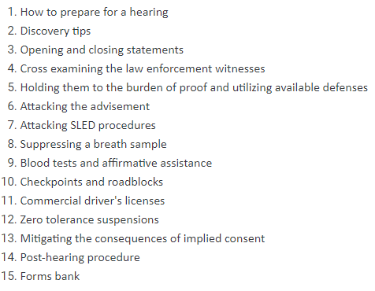
BUY THOMAS NELSON’S (IC) HANDBOOK

Slide 110
SCOPE OF IMPLIED CONSENT HEARING
Section 56-5-2951 (F):
Lawfully arrested or detained;
Given a written copy and verbally informed of I/C rights;
Refused to submit to a test; or
Consented to the test; and
Alcohol concentration was 0.15% or more;
Test operator was qualified;
Sample obtained pursuant to S.C. Code Ann. § 56-5-2950; and
Machine was working properly.

Slide 111
IMPLIED CONSENT TESTING: BREATH TEST
A breath sample taken for testing must be collected within two (2) hours of the arrest.
Before the breath test is administered, an eight one-hundredths of one percent simulator test must be performed and the result must reflect a reading between 0.076 percent and 0.084 percent.

Slide 112
IMPLIED CONSENT TESTING: BREATH TEST
At the direction of the arresting officer, the person first must be offered a breath test to determine the person’s alcohol concentration.
If the person is physically unable to provide an acceptable breath sample because the person has an injured mouth, is unconscious or dead, or for any other reason considered acceptable by the licensed medical personnel, the arresting officer may request a blood sample to be taken.
The breath test must be administered by a person trained and certified by the South Carolina Criminal Justice Academy, pursuant to SLED policies.

Slide 113
IMPLIED CONSENT:BREATH TEST
Chisolm v. S.C. DMV, 402 S.C. 593, 741 S.E.2d 42 (Ct. App. 2013)
Evidence was insufficient to support finding that licensee refused to take an alcohol breath test, in proceeding challenging the suspension of licensee’s driver’s license based on her alleged refusal to take a breath test; licensee agreed to the breath test, she blew into the machine, the instrument produced a steady tone for an extended period of time, even though the machine ultimately did not register licensee’s breath sample, it never indicated that she was not blowing an adequate sample, and licensee asked to take a second test.

Slide 114
IMPLIED CONSENT TESTING: URINE SAMPLE
If the officer has reasonable suspicion that the person is under the influence of drugs other than alcohol or is under the influence of a combination of alcohol and drugs, the officer may order that a urine sample be taken for testing.

Slide 115
IMPLIED CONSENT TESTING: BLOOD AND URINE SAMPLES
Any additional tests to collect other samples must be collected within three (3) hours of the arrest.
Blood and urine samples must be obtained by physicians licensed by the State Board of Medical Examiners, registered nurses licensed by the State Board of Nursing, and other medical personnel trained to obtain the samples in a licensed medical facility.
Blood and urine samples must be obtained and handled in accordance with procedures approved by SLED.

Slide 116
IMPLIED CONSENT: NO COLLATERAL ESTOPPEL
State v. Bacote, 331 S.C. 328, 503 S.E.2d 161 (1998)
Administrative license revocation proceeding does not collaterally estop state from litigating same issues in ensuing criminal prosecution for (DUI).

Slide 117
IMPLIED CONSENT: AFFIRMATIVE ASSISTANCE
City of Columbia, 325 S.C. 644, 482 S.E.2d 781 (Ct. App. 1997)
Defendant had reasonable opportunity to obtain independent blood test following his refusal to take breathalyzer test after arrest for (DUI), and thus requirements of implied consent statute were met, where arresting officer complied with defendant’s request to be taken to hospital for blood test, notwithstanding fact that hospital would not perform test unless authorized by officer and officer refused to request test.

Slide 118
MISC. ISSUES

Slide 119
RIGHT TO COUNSEL DENIED
State v. Degan, 305 S.C. 369, 409 S.E.2d 346 (1991)
A driver arrested for (DUI) was not entitled to consult her attorney prior to deciding whether to take a breathalyzer test since the administration of the test is not a critical stage of the DUI proceeding and, since a defendant has no constitutional right to refuse to submit to chemical analysis, under the implied consent law she had consented to the test.

Slide 120
ARREST
State v. Manning, 400 S.C. 257, 734 S.E.2d 314 (Ct. App. 2012)
Officer who met defendant at hospital after defendant was transported from scene of single-car accident had probable cause to arrest defendant for felony (DUI), based on statement made to him by Highway Patrol officer indicating defendant was driver, his observations at hospital that defendant smelled of alcohol, and his observations that defendant sustained trauma consistent with having been in an accident.

Slide 121
JURISDICTION:AUTHORITY TO DETAIN
State v. Alexander, 424 S.C. 270, 818 S.E.2d 455 (2018)
Respondent was charged by the state trooper with Driving Under the Influence (DUI). The magistrate court granted Respondent’s motion to dismiss the case, finding the officer lacked authority to detain Respondent because the vehicle came to rest outside the municipality’s limits.
On appeal, the State argued that the officer had the authority to detain Respondent pursuant to section 17-13-45 because it extends an officer’s authority when he is responding “to a distress call or a request for assistance in an adjacent jurisdiction.” S.C. Code Ann. § 17-13-45 (2014).
We granted certiorari to review the court of appeals’ decision, which held the statute did not apply to this case. We reverse the court of appeals’ decision because section 17-13-45 provided the officer with authority to detain Respondent and we remand this case for further proceedings.

Slide 122
JURY Q: CIRCUMSTANTIAL EVIDENCE
State v. Russell, 345 S.C. 128, 546 S.E.2d 202 (Ct. App. 2001)
Defendant's extra-judicial statements were sufficiently corroborated to be admissible to establish corpus delicti, and
Whether Defendant was guilty was a question for the jury.

Slide 123
LAY WITNESS TESTIMONY
State v. Ramey, 221 S.C. 10, 68 S.E.2d 634 (Ct. App. 1952)
A lay witness may testify whether in his opinion a person was drunk or sober on a given occasion on which witness observed such person.

Slide 124
DIRECTED VERDICT
State v. Breech, 308 S.C. 356, 417 S.E.2d 873 (1992)
In a trial for driving under the influence of alcohol, sufficient evidence existed to withstand a motion for a directed verdict where the arresting officer testified that he (1) observed the defendant driving erratically, (2) stopped the defendant and noticed a strong smell of alcohol, and (3) administered several field sobriety tests, all of which indicated that the defendant was under the influence of alcohol.

Slide 125
DIRECTED VERDICT
State v. Gilliam, 270 S.C. 345, 242 S.E.2d 410 (1978)
Evidence was sufficient to support submission of case to jury where (1) defendant, charged with driving under influence, was discovered alone on passenger side of wrecked automobile, (2) tow truck operator testified defendant appeared to be under influence, (3) defendant admitted driving automobile when interviewed at hospital, and (4) open bottle of alcoholic beverage was found in automobile.

Slide 126
JURY Q: CIRCUMSTANTIAL EVIDENCE
State v. Russell, 345 S.C. 128, 546 S.E.2d 202 (Ct. App. 2001)
Whether defendant was guilty of (DUI) was a question of fact for the jury, as corpus delicti of crime was established by circumstantial evidence that the car was operated in the state, by defendant’s admission that he was highly intoxicated, and by his extra-judicial statements to police that he was driving, which were sufficiently corroborated by independent facts.

Slide 127
OFFICER ALLOWED TO PROSECUTE AFTER LEAVING AGENCY
State v. Rainwater, 376 S.C. 256, 657 S.E.2d 449 (2008)
Police officer was qualified to prosecute defendant’s driving (DUI) case in the magistrate court after the officer transferred to another law enforcement agency; officer was the arresting officer and the person able to testify regarding the events surrounding the arrest.

Slide 128
DUI ON PRIVATE PROPERTY
State v. Allen, 314 S.C. 539, 431 S.E.2d 563 (1993)
Section 56-5-2930, prohibiting driving under the influence, applied to defendant who operated vehicle on private property since the DUI statute is not limited to public highways but applies to property anywhere within state boundaries.

Slide 129
DUI ON PRIVATE PROPERTY: CONT.
State v. Allen, 314 S.C. 539, 431 S.E.2d 563 (1993)
Statute prohibiting DUI applied to defendant who operated motor vehicle in driveway of private residence, regardless of whether property owner provided written consent to application of Uniform Act Regulating Traffic on driveway.

Slide 130
MOPED CAN BE MOTOR VEHICLE
State v. Singleton, 319 S.C. 312, 460 S.E.2d 573 (1995)
Although mopeds are exempted from registration, licensing, and insurance requirements as vehicles, the General Assembly intended that the (DUI) statute, § 56-5-2930, embrace the driving of a moped, and thus the trial judge did not err in charging the jury that a moped is a vehicle as contemplated by the DUI statute.

Slide 131
NOT LESSER-INCLUDED OFFENSES
State v. Cribb, 310 S.C. 518, 426 S.E.2d 306 (1992)
Reckless Driving, Reckless homicide, and involuntary manslaughter are not lesser included offenses of felony driving under the influence (DUI) since recklessness is not required to support a conviction for felony DUI, thus overruling prior case law to the contrary.

Slide 132
SPEEDY TRIAL
Barker v. Wingo, 407 U.S. 514 (1972)
State v. Langford, 400 S.C. 421, 735 S.E.2d 471 (2012)
S.C. Code Ann. § 17-23-90
Rules 3(c) and 14(c), SCRCrimP

Slide 133
SPOLIATION OF EVIDENCE
Arizona v. Youngblood, 488 U.S. 51, 58 (1988)
State v. Cheeseboro, 346 S.C. 526, 538-39 (2001)
If denied, move to suppress any testimony related to the evidence.

Slide 134
SEVERANCE OF CHARGES
S.C. Code § 17-25-50
State v. Smith, 322 S.C. 107, 108, 470 S.E.2d 364, 365 (1996)
State v. Middleton, 288 S.C. 21, 339 S.E.2d 692 (1986)

Slide 135
SEVERANCE OF JOINT TRIAL
Zafiro v. United States, 506 U.S. 534 (1993)
State v. Dennis, 337 S.C. 275, 523 S.E.2d 173 (1999)
State v. Singleton, 303 S.C. 313, 315, 400 S.E.2d 487, 488 (1991)

Slide 136
MOTIONS IN LIMINE
Purpose of a motion in limine is to prevent disclosure of potentially prejudicial matter to the jury.
Ruling on the motion is not a final ruling on the admissibility of evidence because the ruling is subject to change based upon developments during the trial.

Slide 137
MOTIONS TO SUPPRESS EVIDENCE
Search and Seizure issues
Denno Hearing – Involuntary Statements
Biggers Hearing – Unreliable Identification
Redactions

Slide 138
SEARCH AND SEIZURE ISSUES
Heightened Protection for Unreasonable Invasions of Privacy (More than the 4th Amendment)
State v. Counts, 413 S.C. 153, 776 S.E.2d 59 (2015)
Created a new standard that law enforcement must have reasonable suspicion of illegal activity at a targeted residence prior to approaching the residence without a warrant under the heightened privacy protection afforded by the SC Constitution.

Slide 139
DENNO HEARING
Admissibility of Statements by Defendant
Jackson v. Denno, 378 U.S. 368 (1964) (voluntariness of the statement).
Miranda v. Arizona, 384 U.S. 436 (1966)
Edwards v. Arizona, 451 U.S. 477 (1981)
Miranda required when def. is in custody.

Slide 140
DENNO HEARING
NOTE: Although the evidence is related, there is a difference between an in camera hearing to determine if a person was in custody and entitled to Miranda warnings and a Jackson v. Denno hearing to determine whether a confession or statement was voluntary. State v. Silver, 314 S.C. 483, 431 S.E.2d 250 (1993).

Slide 141
REDACTIONS
Documents, Audio, and Video:
Must comply with the Rules of Evidence
C0-defendant’s confessions in a joint trial:
Bruton v. United States, 391 U.S. 123 (1968)
State v. Jackson, 410 S.C. 584, 765 S.E.2d 841 (Ct. App. 2014).

Slide 142
ADMISSIBILITY OF EVIDENCE
Cite the applicable rule of evidence
Due Process is a companion argument.
Study the Rules of Evidence
Must read the cases dealing with these rules to fully understand how they are applied at trial.

Slide 143
RULE 403, SCRE EXCLUSION OF RELEVANT EVIDENCE
More than prejudice: Confusion of the issues, misleading the jury, needless presentation of cumulative evidence.
Focus on the actual probative value: Why is the Solicitor trying to admit this evidence?
Photographs and Video

Slide 144
COMMON MISTAKES (TRIAL)
Directed Verdict of Acquittal – You must specify which element was not met AND renew at the end of the defendant’s case.
Jury Instructions: If the court refuses to give a requested jury instruction, the excluded instruction must be marked as a court’s exhibit, specifically identified, and sufficiently argued.

Slide 145
COMMON MISTAKES (TRIAL)
Objections to jury instructions: You must object to the specific jury instruction (e.g., provide constitutional argument, it is not enough to say, “I object to numbers 1, 3, 6”). Read out the entire instruction and argue why it should not be charged.
Remember to renew your objection(s) and/or request(s) after the court’s instructions to the jury.

Slide 146
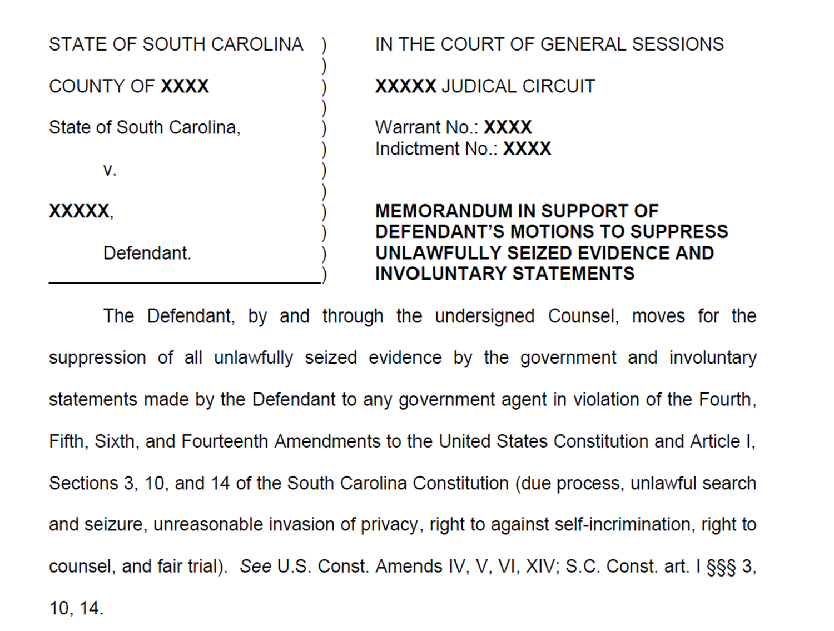

Slide 147
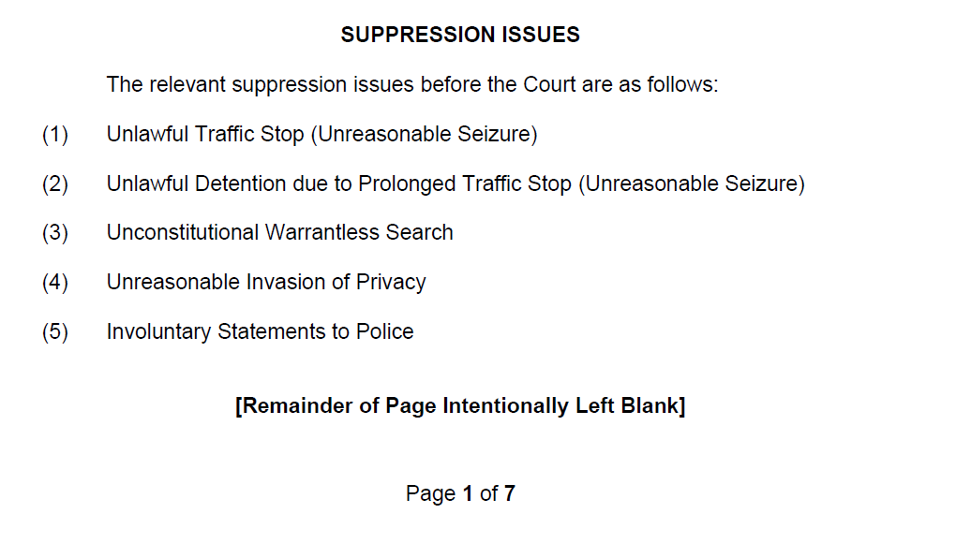

Slide 148
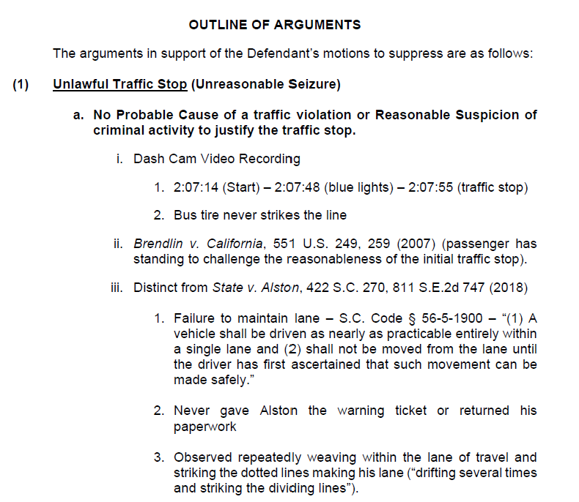

Slide 149
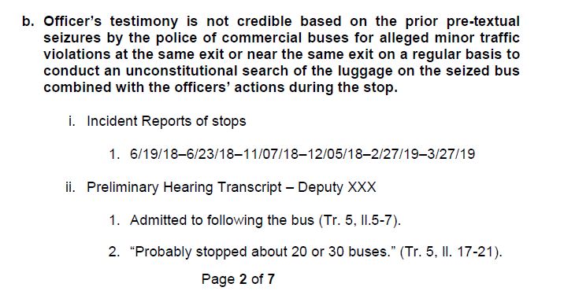

Slide 150
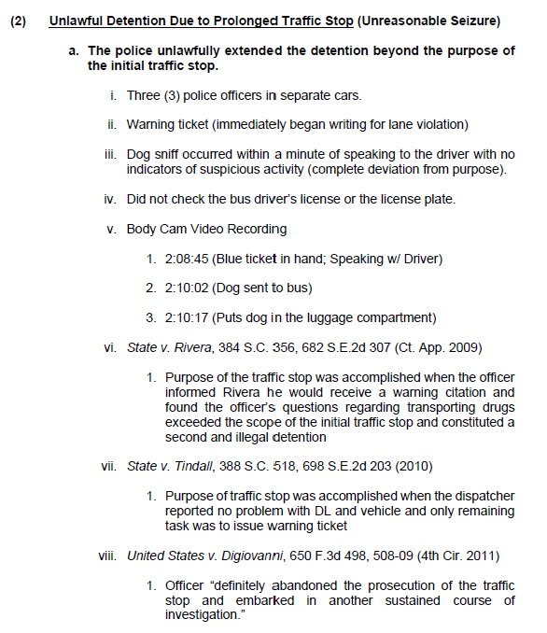

Slide 151
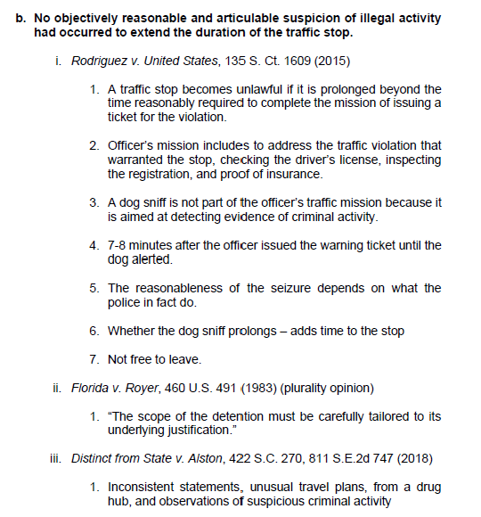

Slide 152
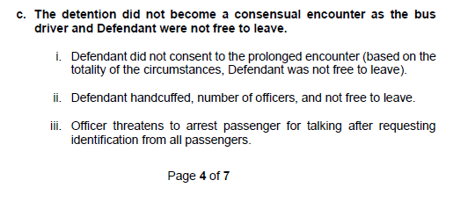

Slide 153
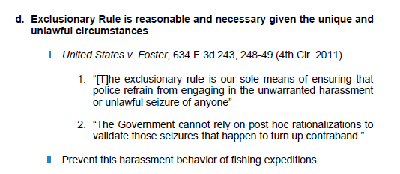

Slide 154
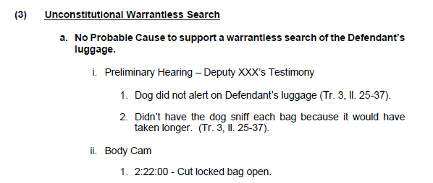

Slide 155
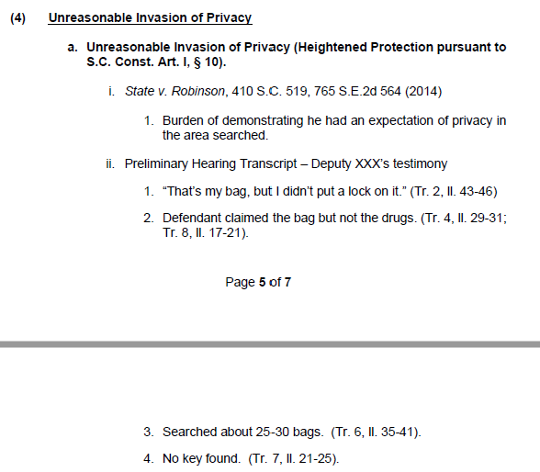

Slide 156
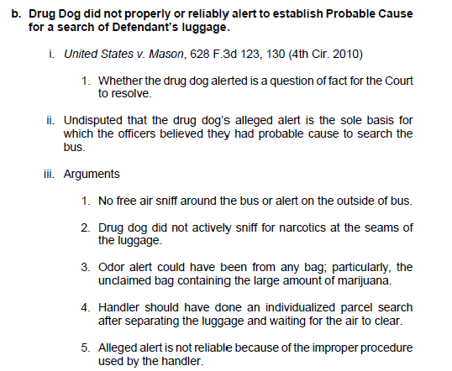

Slide 157
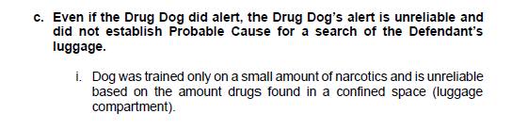

Slide 158
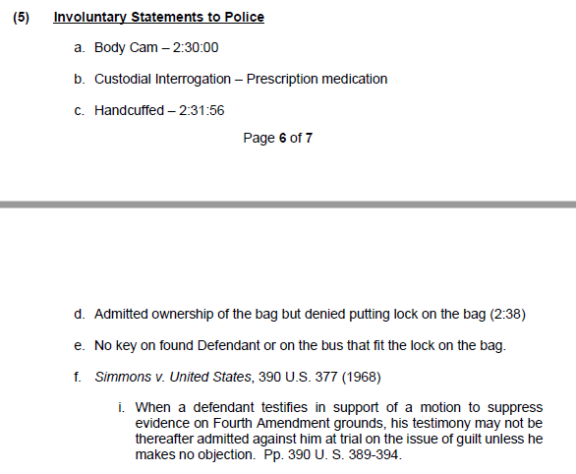

Slide 159
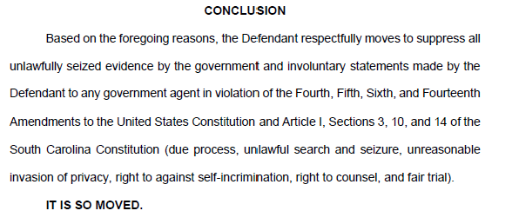

Slide 160
QUESTIONS?
DAYNE PHILLIPS
PRICE BENOWITZ LLP
Cell - (803) 807-0234
dayne@pricebenowitz.com
www.SCCriminalLaws.com

